Slide 1

Characterizing the Regulatory Framework in an Aggressive Breast Cancer Phenotype: A Bayesian Regression-Based Enhancement
George Acquaah-Mensah¹ and Anushree Iyengar²
¹MCPHS University, ²Case Western Reserve University

Slide 2
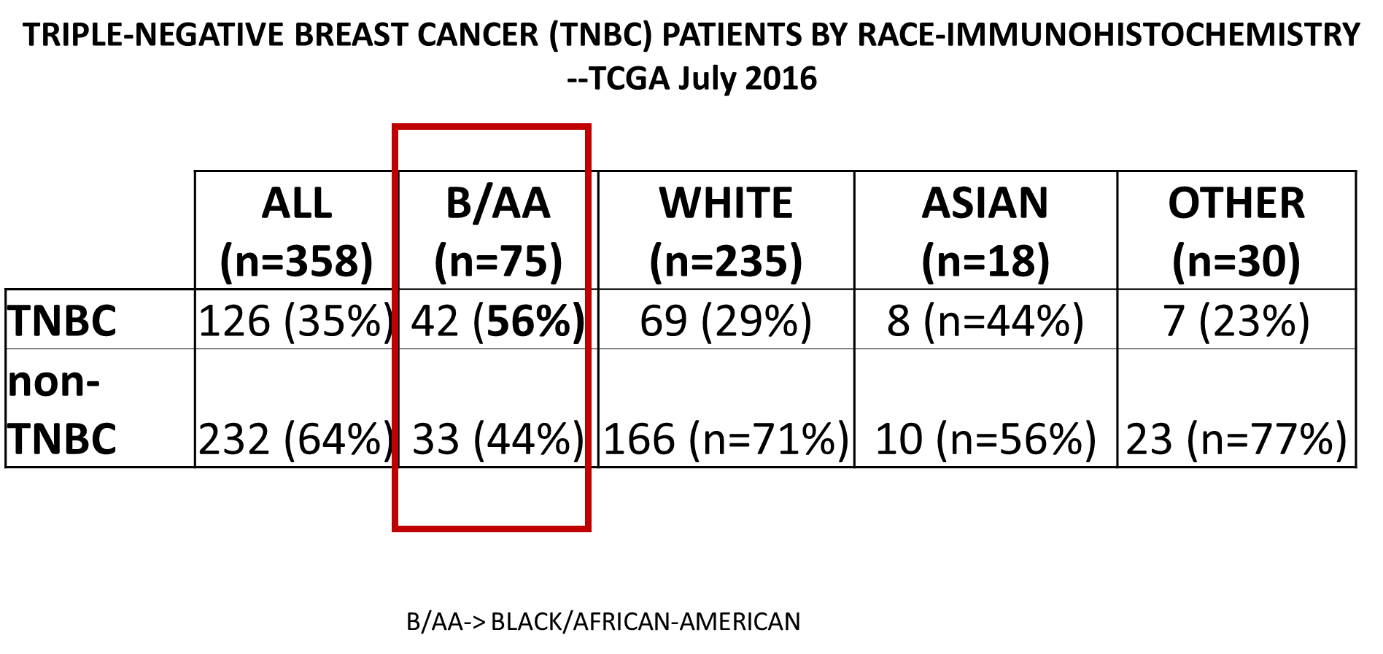
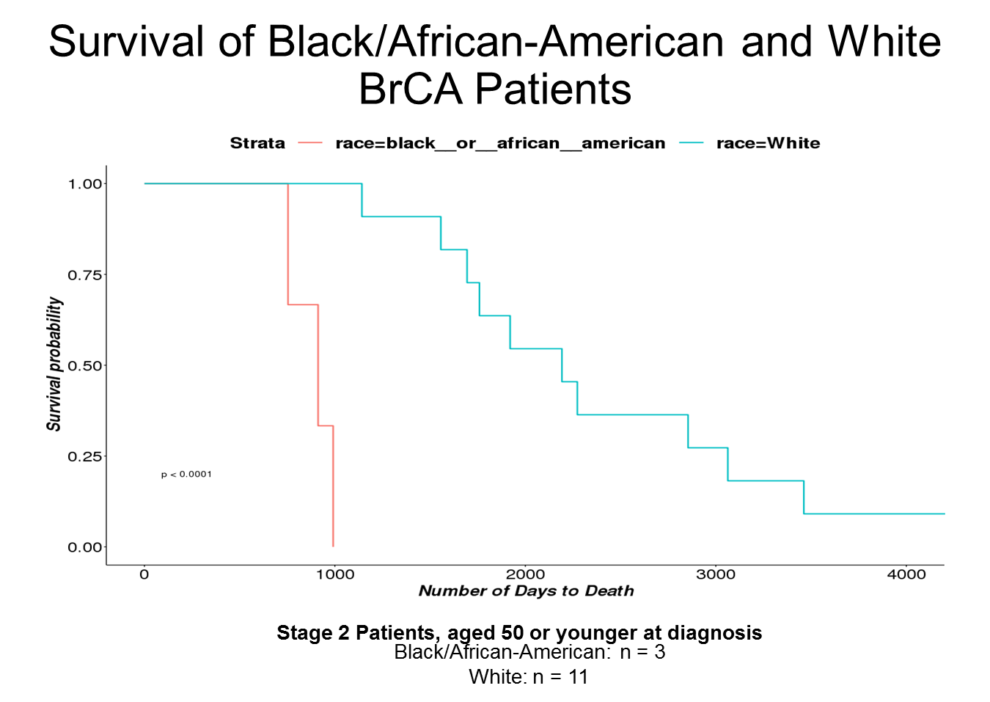
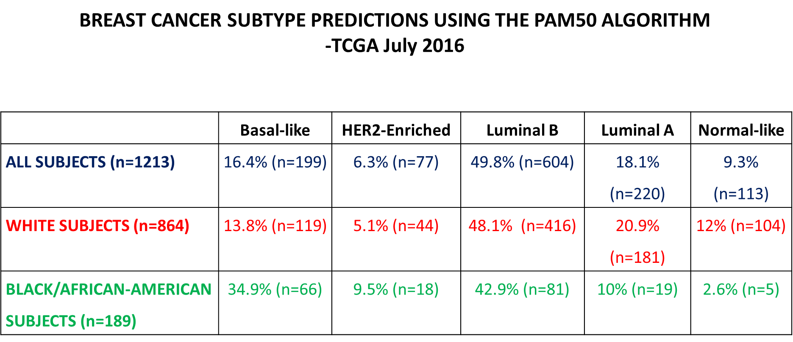
BrCA AGGRESSIVE IN B/AA PATIENTS

Slide 3
APPROACH
INFERELATOR
VIPER
[CHEA ∩JASPAR ∩ DE TFs As Priors]
Bioinformatics
Alvarez et al., 2016

Slide 4
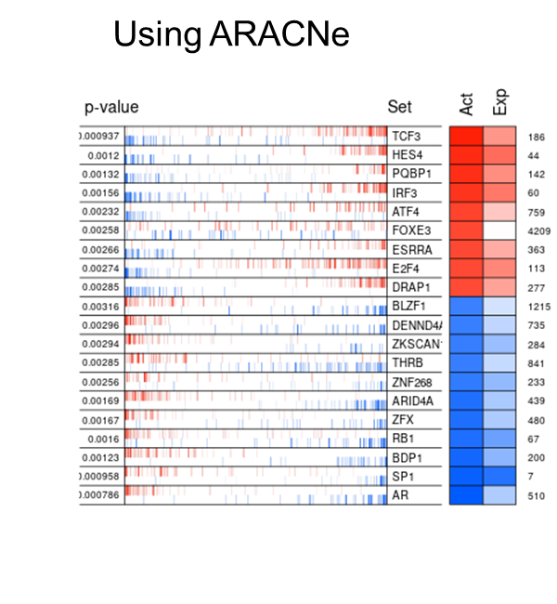
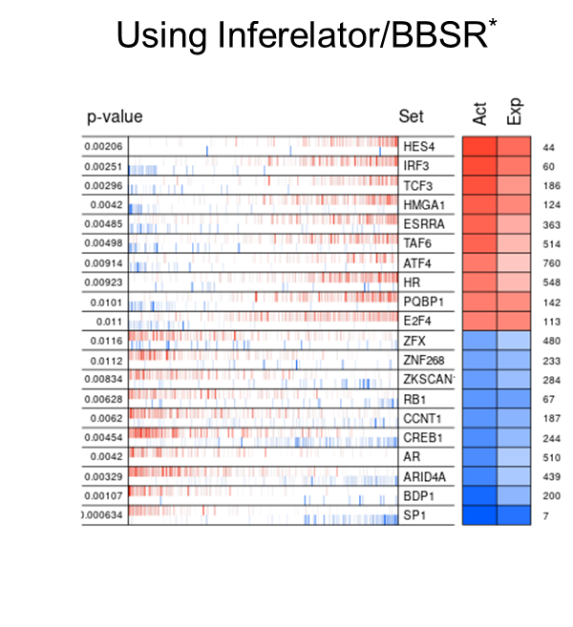

SIMILAR MASTER REGULATORS IDENTIFIED

Slide 5
 | ARACNe | Inferelator
Num Edges | 31882 | 30351
VALIDATIONS
CHEA | 152 | 142
JASPAR_PWM Predictions | 57 | 48
BOTH | 14 | 15
Mean (Abs) NES* | 3.1 | 2.8 | p=0.05
Mean Regulon Size* | 111 | 251 | p=0.05
*Regulons associated with top 20 Master Regulators

Slide 6
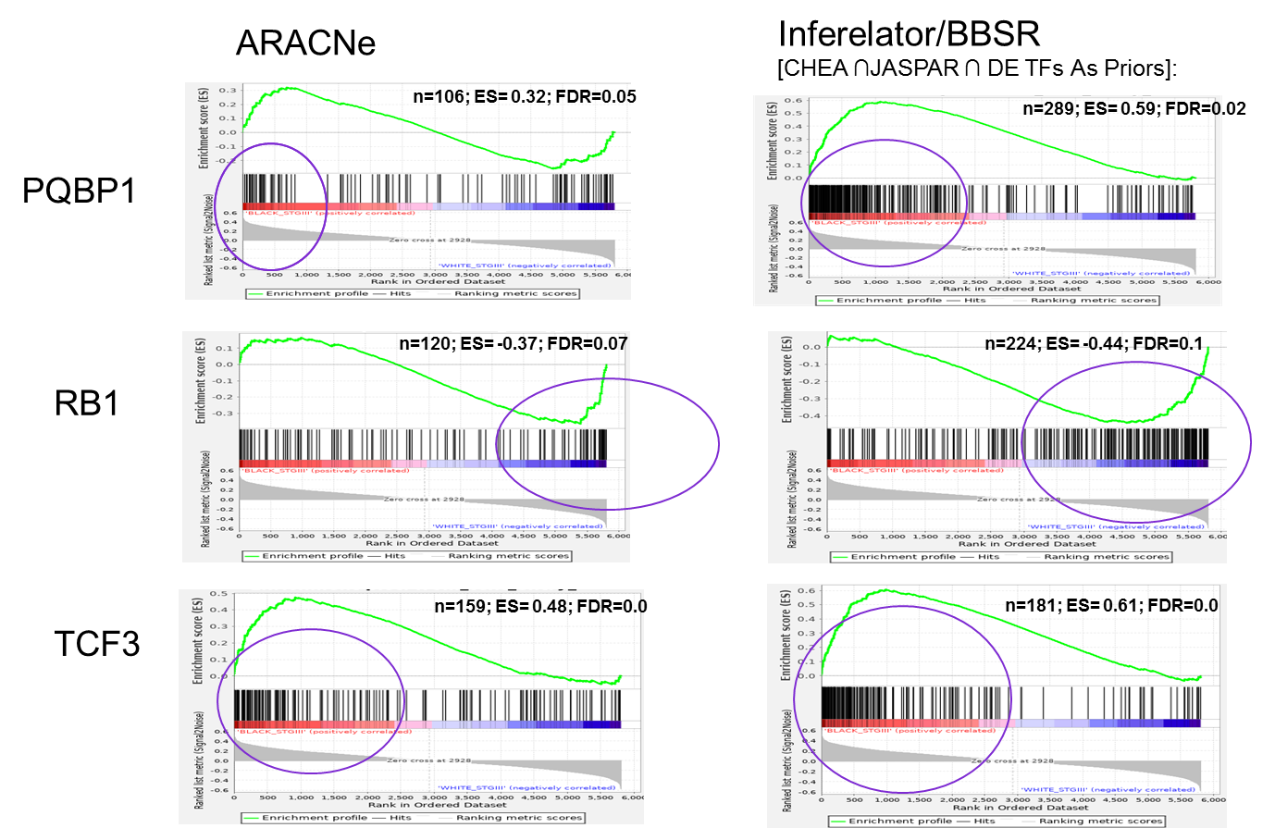
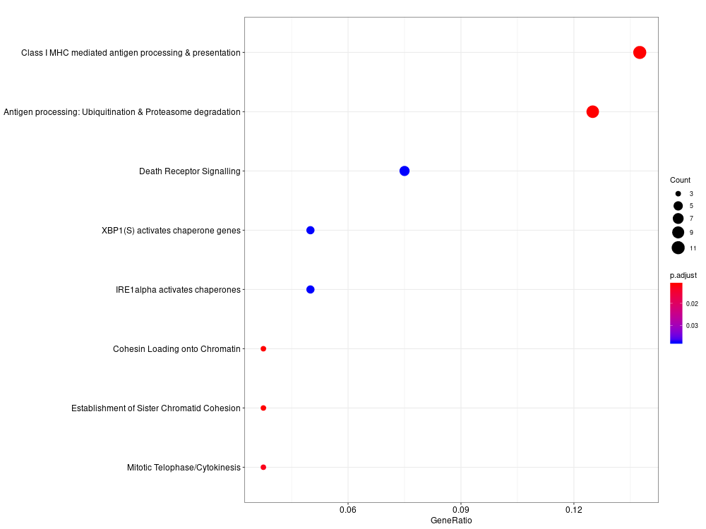
SAMPLE MR REGULONS
ORA: Inferelator/ BBSR: RB1 Regulon LE Genes
Inferelator/BBSR:
More Leading Edge (LE) genes
More cancer biology-relevant pathways over-represented among LE genes

