Slide 1
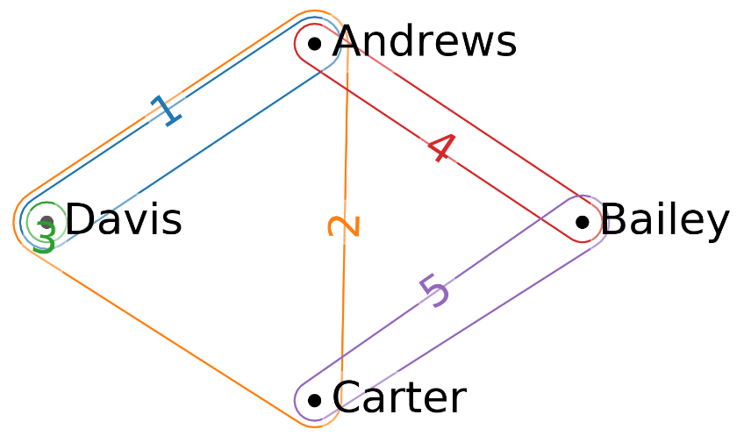
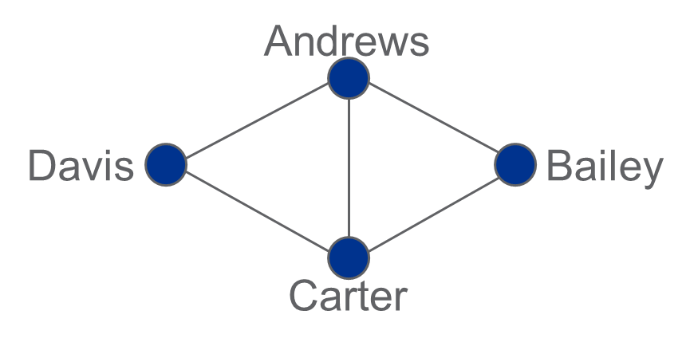
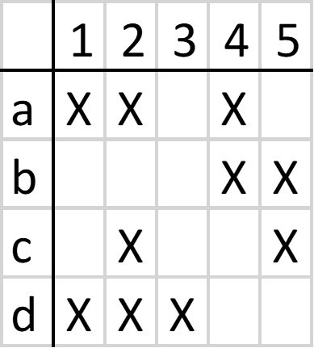
Hypergraph Analytics for Computational Virology
Multi-way interactions cannot be modeled natively by graphs!
  Proteins in pathways, complexes, binding sites
  Groups of proteins/genes significant for a condition
Hypergraphs as multi-dimensional graphs
  Network coding of multi-way relations typically lossy: Pairwise interactions only
Hypergraphs explicitly generalize graphs
Equivalent forms:
  Euler (set) diagram
  Incidence matrix
  Bipartite graph
  Many-many relation
Cliff Joslyn and Hugh Mitchell
Emilie Purvine, Song Feng, Brett Jefferson,
Henry Kvinge, Jason McDermott, Brenda Praggastis
PNNL-SA-149602

Slide 2
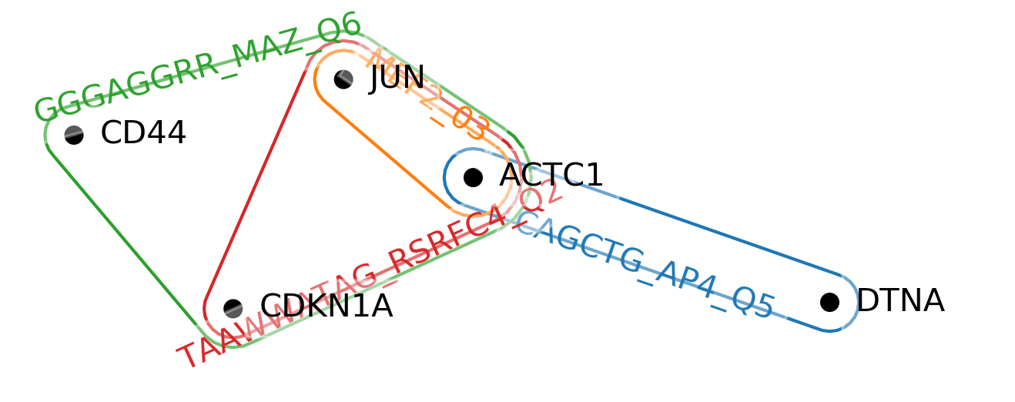
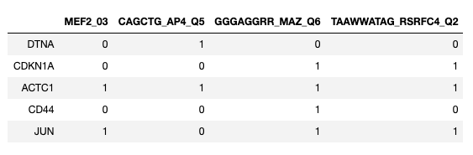
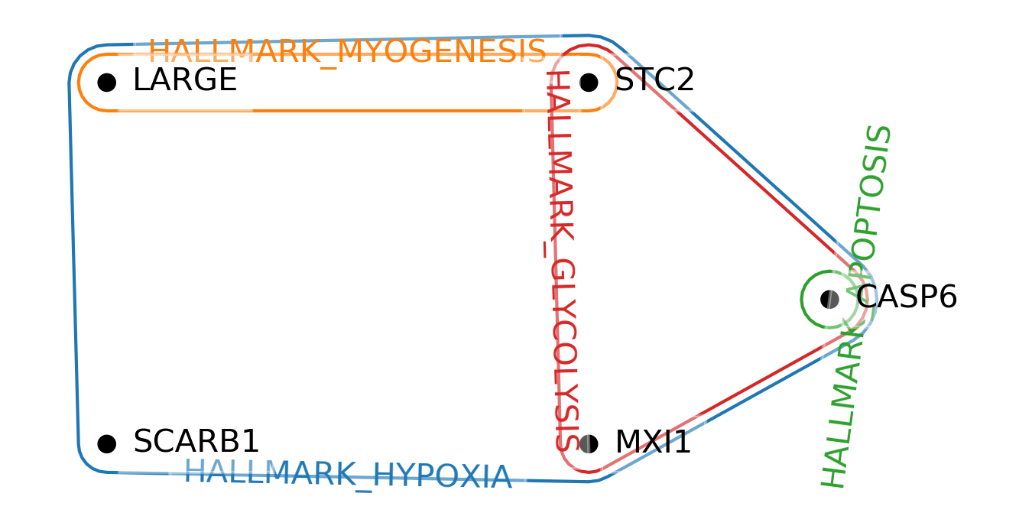
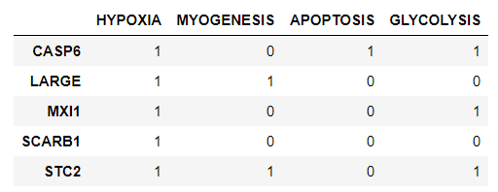
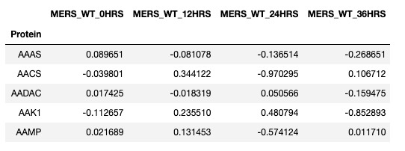
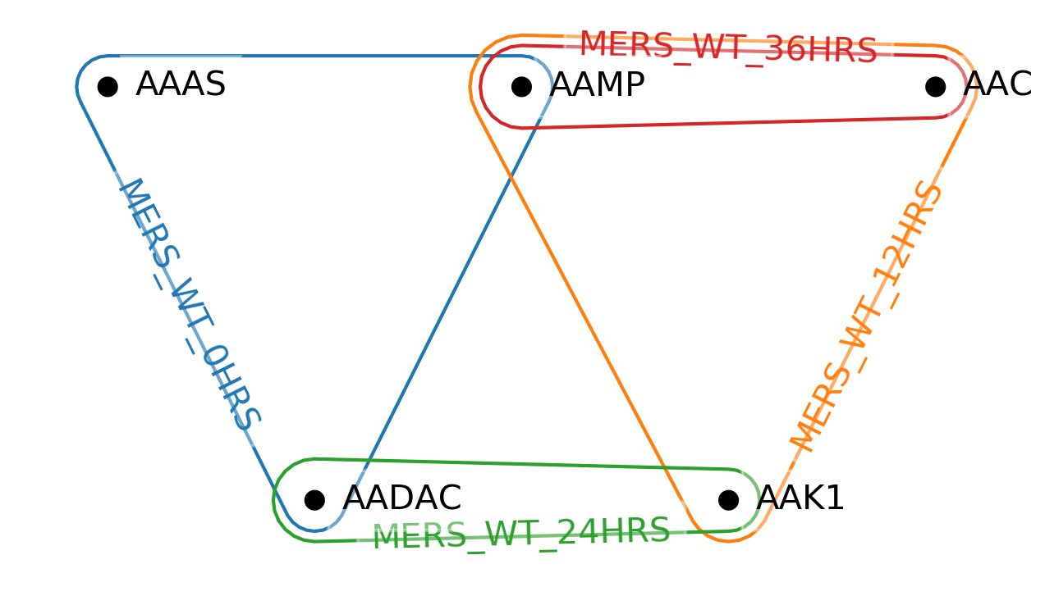
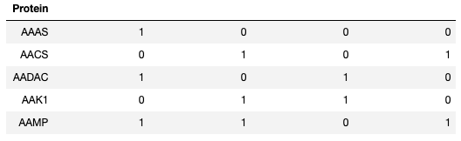
What kind of Data generate Hypergraphs?
Imagine your tabular data:
Attributes: Entities (rows) are indicated as having specific attributes or properties (columns)
  E.g., common transcription factors
Joint relationships: Entities jointly participate in some relationship or activity
  E.g., protein pathways
Numeric data: consider thresholding the data (cell value > 0)
  E.g., ‘omics measurements

Slide 3
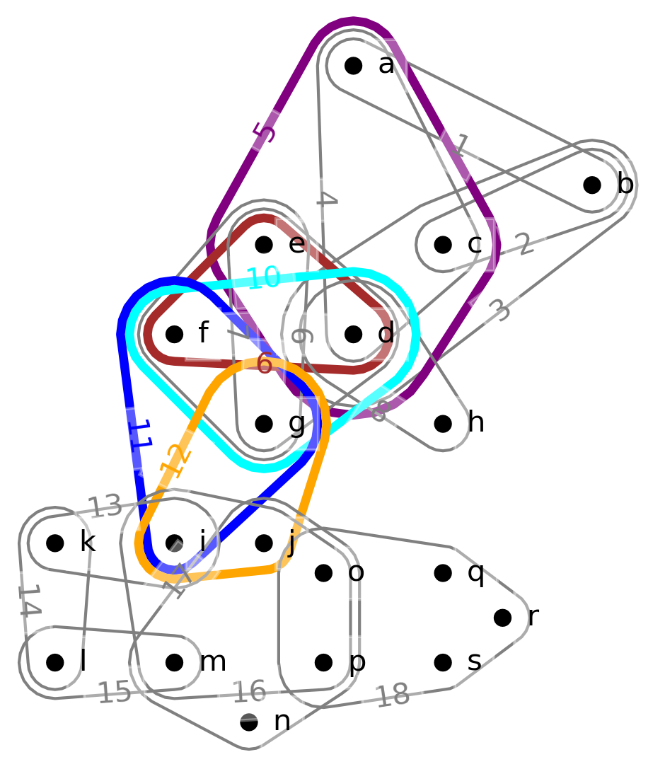
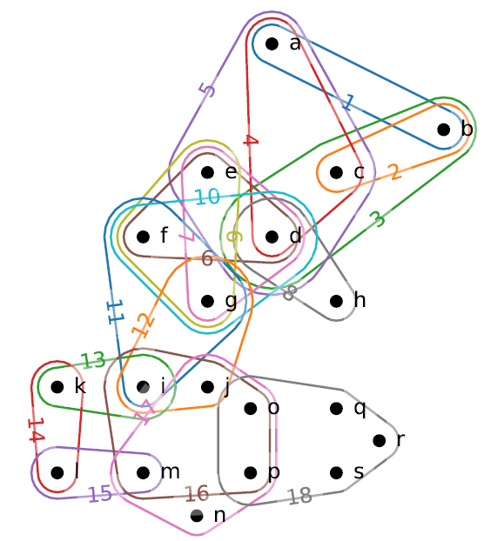
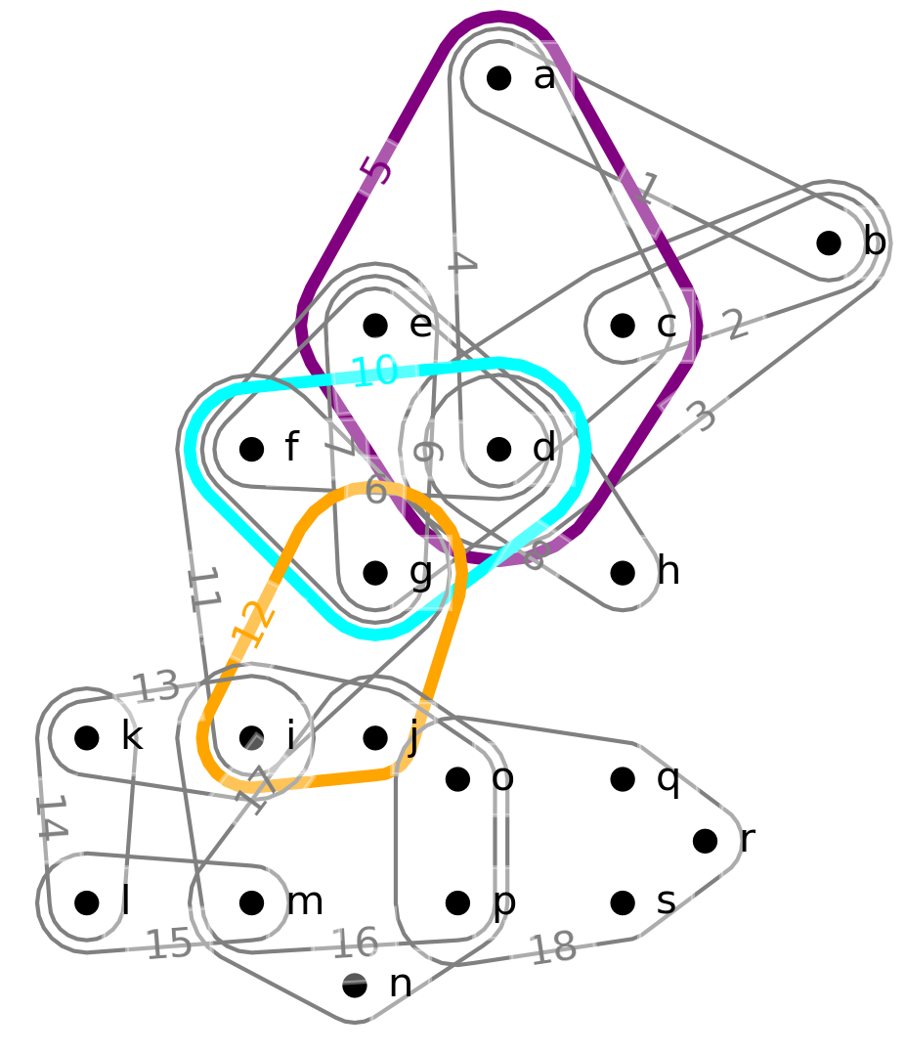
Towards Hypernetwork Science
2-component
Gene with most conditions? Max node degree
Condition with most genes? Max edge size
Pathways of multi-way connected gene sets: s-paths
  5 → 6 → 10 → 11 → 12 (intersections = s = 2)
  5 →10 → 12 (intersections=1)
Gene sets tightly multi-way connected: s-components
Generalize network science methods:
  s-Distance
  s-Diameter
  s-Centralities (closeness, betweenness, degree)
  s-Clustering coefficient
3-component
Aksoy, Sinan G; Joslyn, Cliff A; Marrero, Carlos O; Praggastis, Brenda; Purvine, Emiile: (2019) “Hypernetwork Science via High-Order Hypergraph Walks”, submitted, arXiv:1906.11295

Slide 4
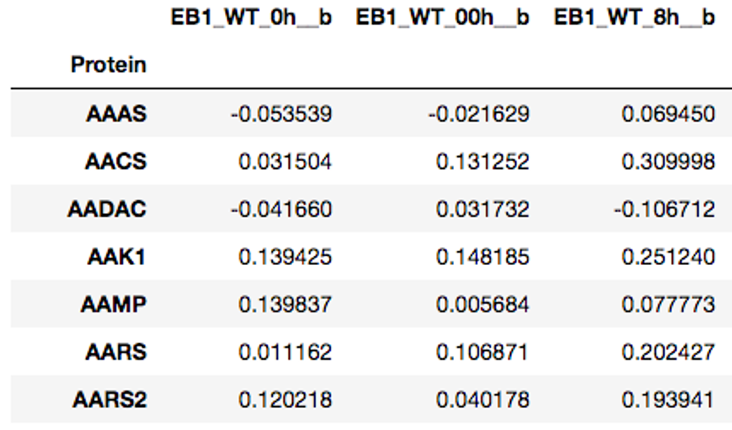
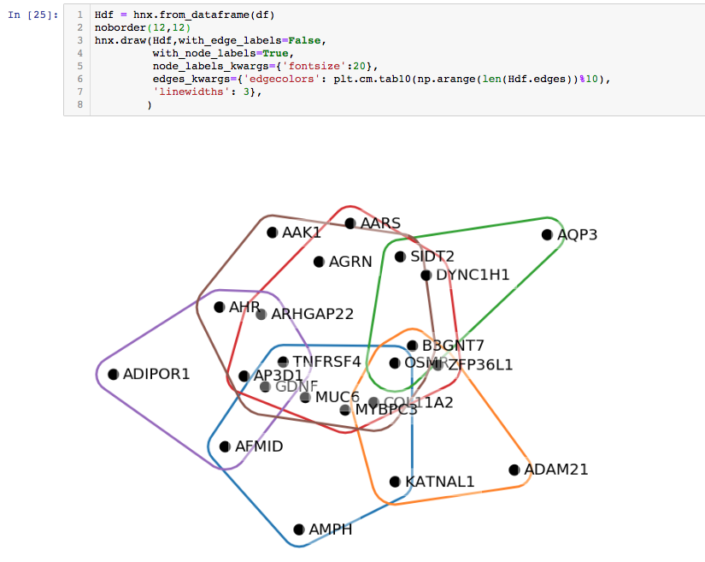
Example Target
Questions
…
Do different viruses (e.g. SARS and MERS) perturb shared sets of genes or proteins?
What genes or proteins are most central in a host response network?
How are genes shared across multiple pathways?
Are there patterns of protein activity that vary with degree of viral pathogenicity?
What are unique patterns elicited by different viruses?
Are signaling pathways activated in similar ways by different viruses?
…
Future work

Slide 5
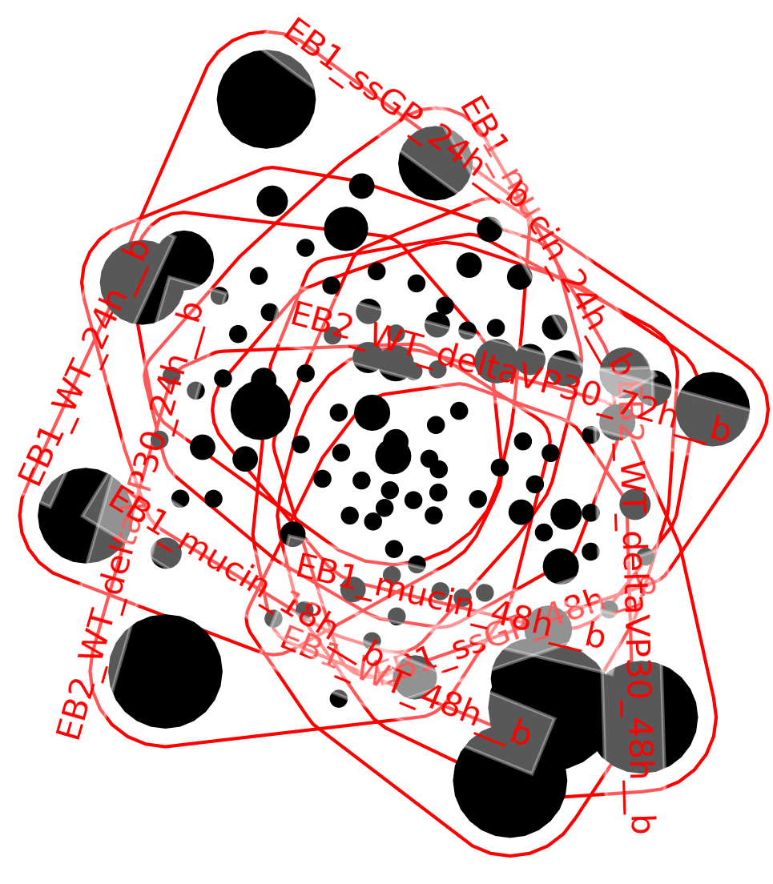
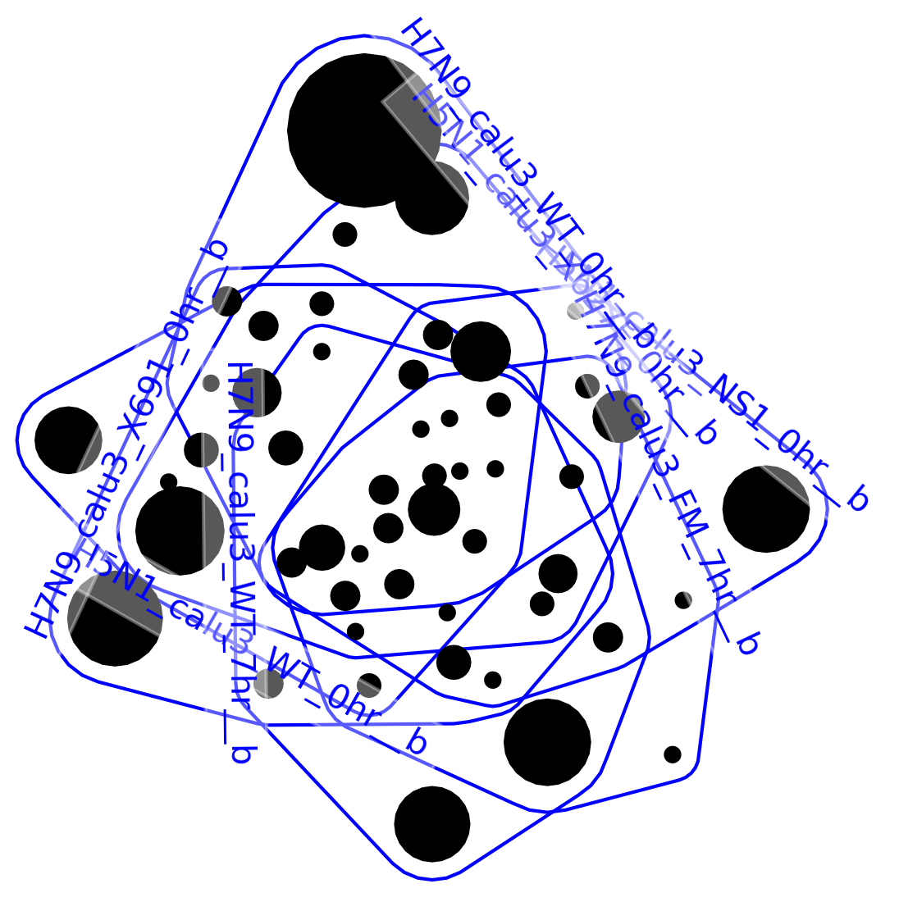
Study of Host
Response Data
Mouse and human cells infected with viral strains: Ebola, Influenza, MERS, SARS, WNV
  Samples analyzed at time points post infection
  Transcriptomics data: Log(fold change) for each [sample, gene] pair relative to control
Hypergraph:
  Nodes = genes; Edges = conditions (virus, strain, cell type, time point, …)
  Node/edge containment = genes with log(fold change) z-score ≥ 3 for a given condition
Compute s-components for a range of s values
  s = 1 (“graph case”): 1 giant component
  s >1: as components break off they tend to
  be formed from single pathogens
  Conclusion: Similarities within pathogen
  stronger than between pathogens
s = 25
s = 40

Slide 6
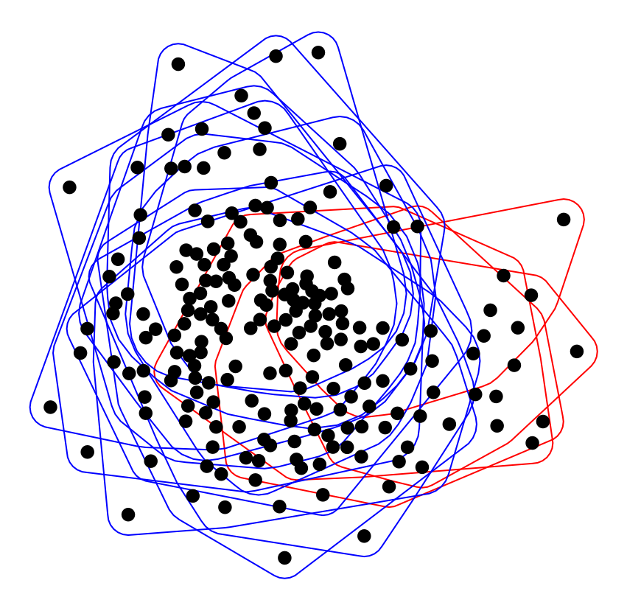
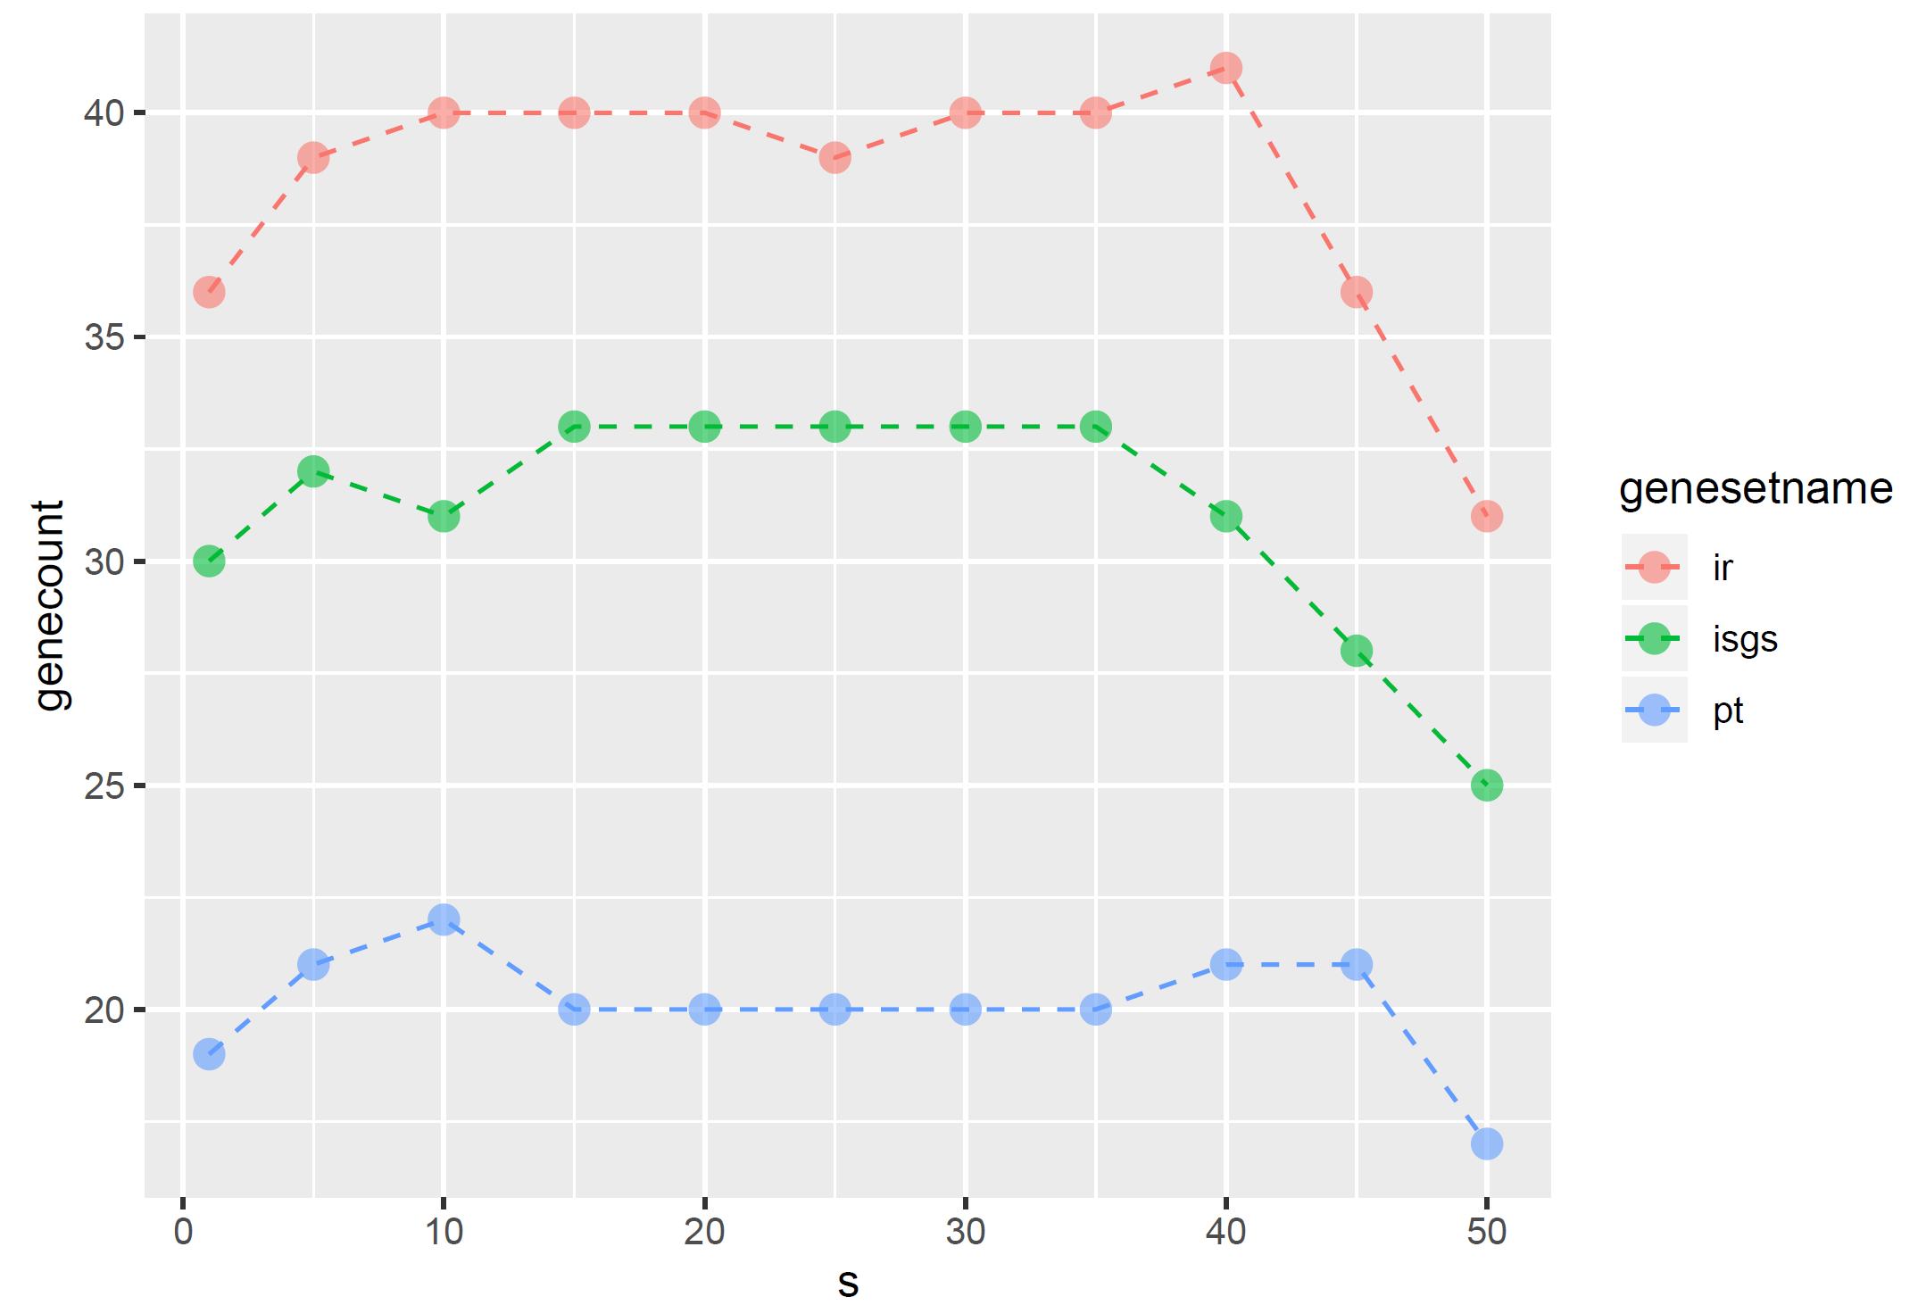
Study of Host
Response Data
s=100 component in hypergraph formed by genes with
log(fold change) ≥ 3 for a given condition
  Late time point SARS and MERS, same tissue type
  All MERS mutants at final time point
  Sole SARS WT and one SARS mutant for > 36h
  Conclusion: SARS and MERS eventually highly up-regulate
  similar genes, with some exceptions
Compute s-closeness centrality to find important genes
  s = 1 is like graph case
  s > 1 shows added value of hypergraph model
  Compare top 50 genes at each s value to list of
  known immune response and pathogen targeted
  genes
  Generally s > 1 sees more known important genes than s=1
  Conclusion: Added complexity from hypergraph
  structures can help discovery important genes
SARS
MERS

