Slide 1


Slide 2


Slide 3

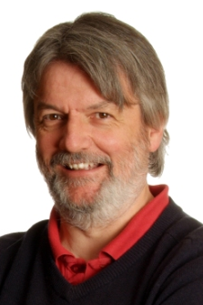
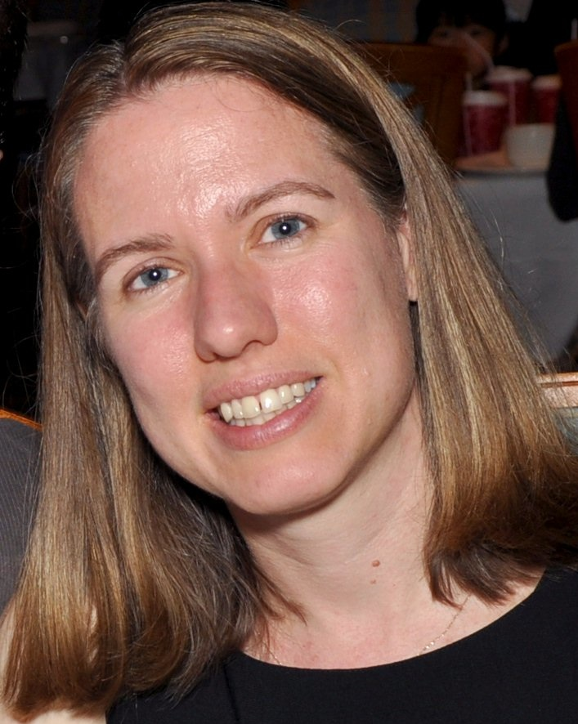
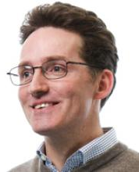
Conference honorary chair
Des Higgins
School of Medicine & Medical Science, Conway Institute, University College Dublin, Ireland
Conference co-chairs
Janet Kelso
Max Planck Institute for Evolutionary Anthropology, Leipzig, Germany
Alex Bateman
University of Cambridge to
the Euorpean Bioinformatics Institute (EMBL-EBI),
United Kingdom

Slide 4
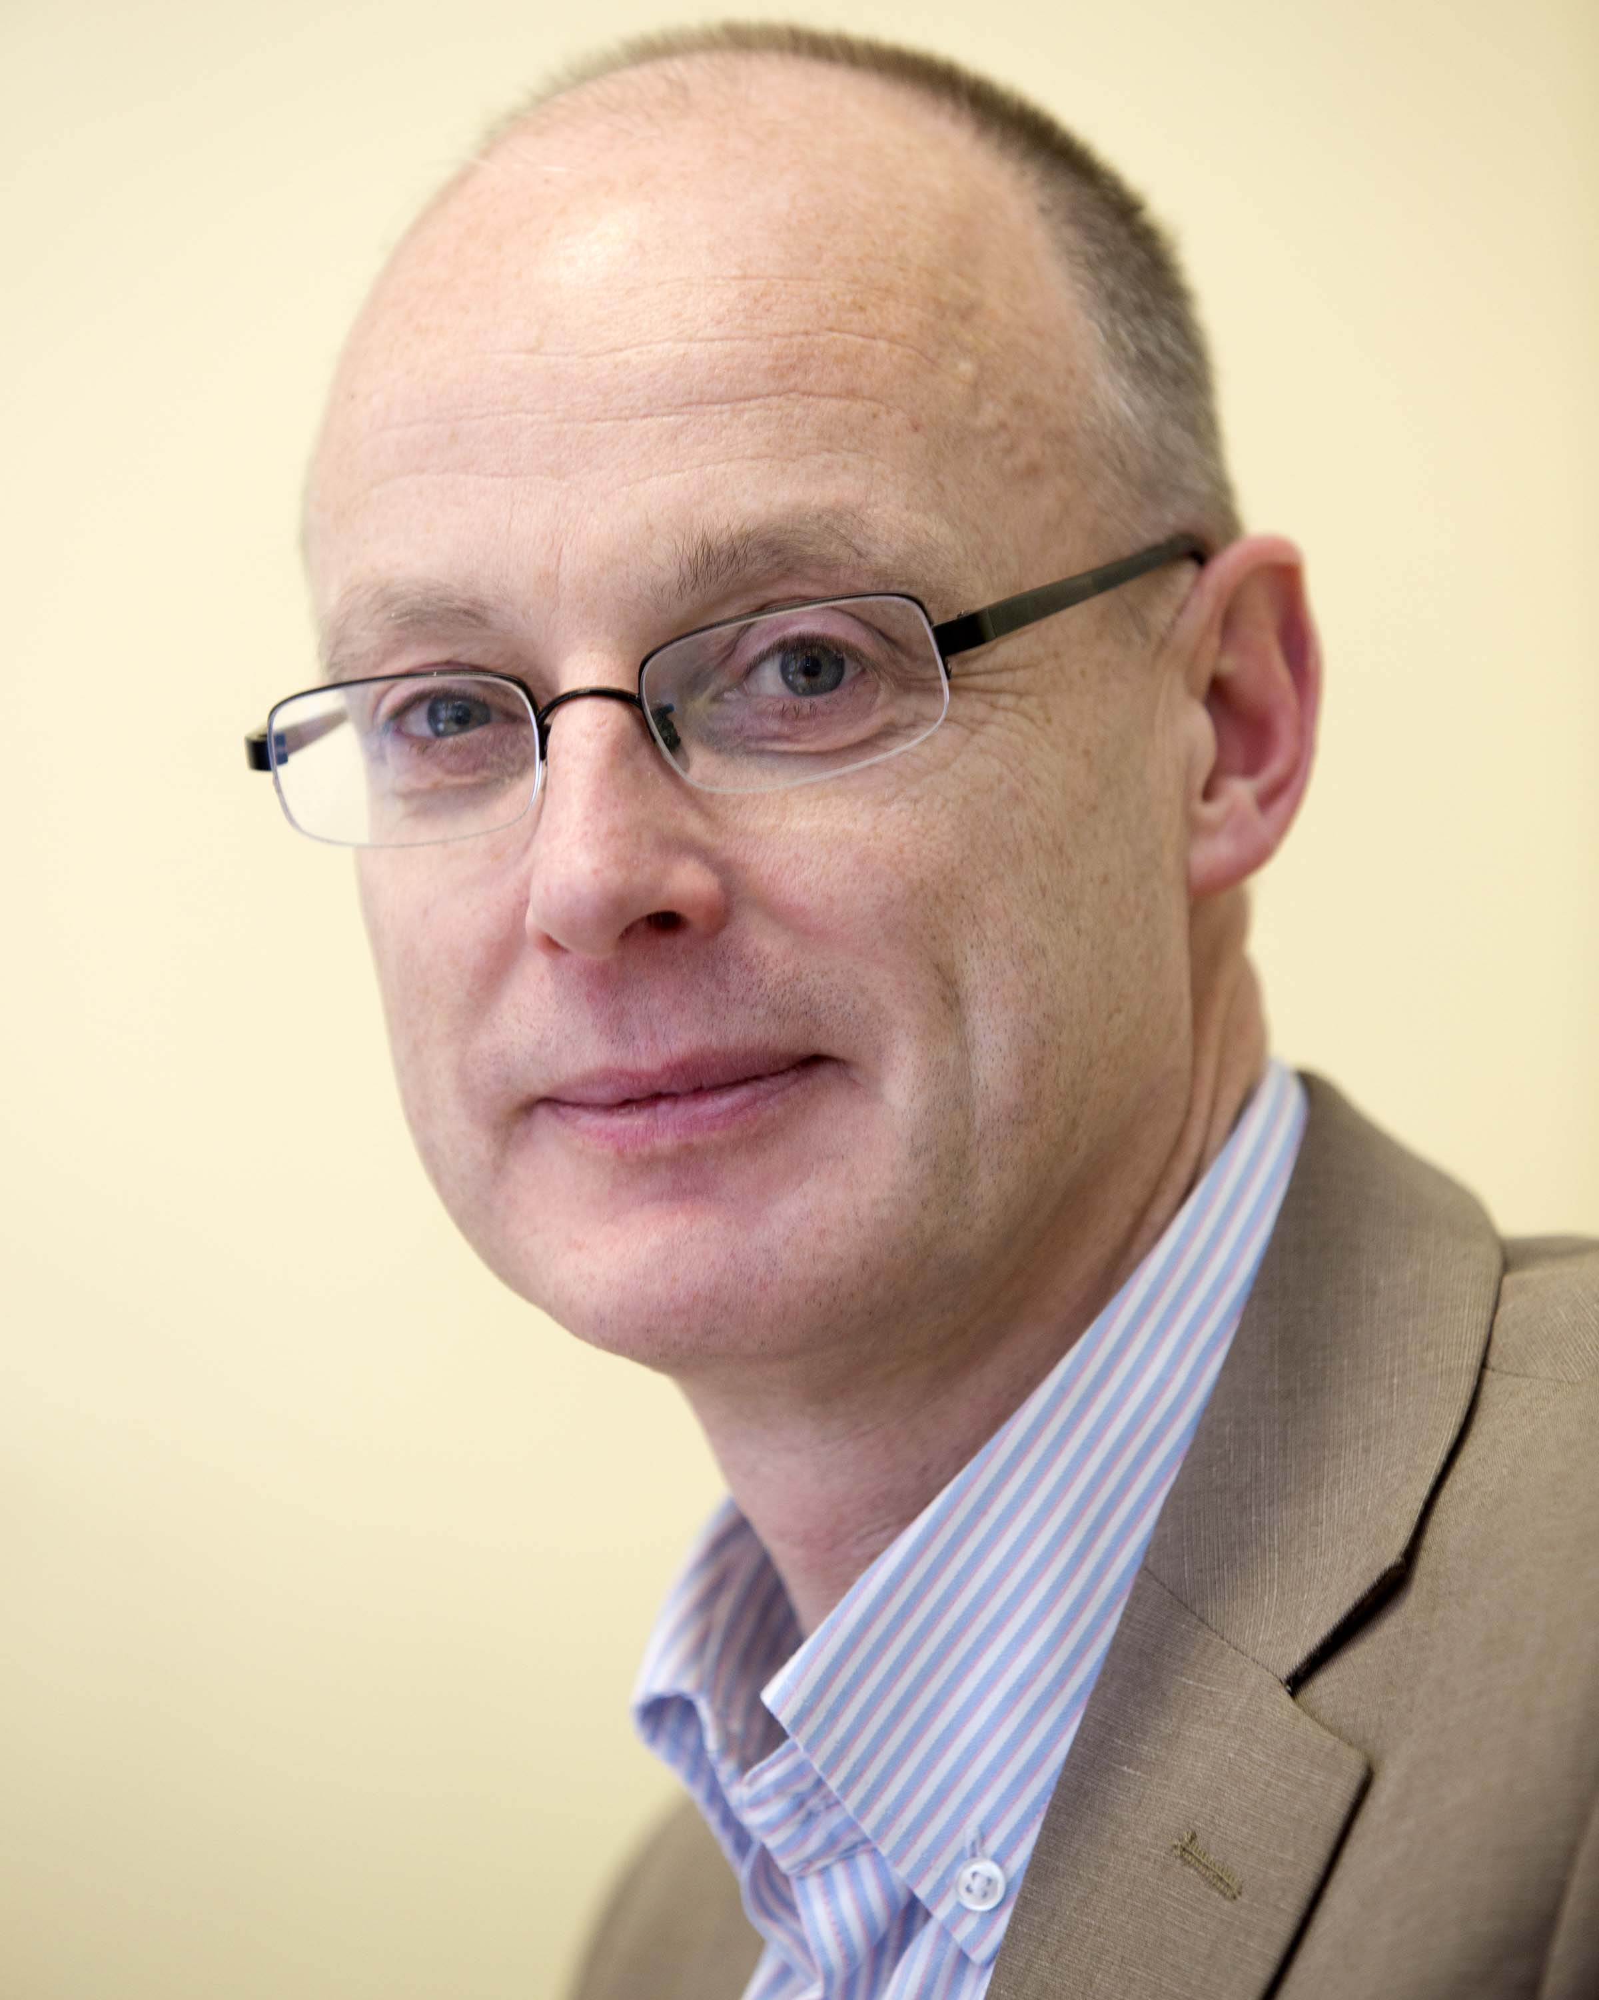
Confirmed keynote speakers
Eileen Furlong
European Molecular Biology Laboratory (EMBL)
Heidelberg, Germany
Kenneth H Wolfe
School of Medicine & Medical Science, Conway Institute, University College Dublin, Ireland

Slide 5


