Slide 1





Teaching How to Scale Science (and People) Using Cloud Resources
Nirav Merchant
The University of Arizona
nirav@email.arizona.edu
http://www.cyverse.org Twitter: @CyVerseOrg
Notes:
Focus here is on genomics data, but not restricted to genomics data

Slide 2
Topic Coverage:
My Motivation (for teaching cloud)
Pragmatic approaches (as a cloud provider and consumer)
Exemplar courses and workshops (that leverage cloud)
Teaching complex stack/technology through project based learning (my experience)
Future direction

Slide 3
Motivation for teaching/using cloud:
Early 2000, many students from our Bioinformatics course (MCB 416/516 with David Mount) with computational expertise were getting (postdoc and faculty) placement at academic institutes with limited (no) institutional computational infrastructure
U. Arizona awarded NSF IGERT & NIH PERT, both with active engagement with local community colleges and PUI
These new postdoc and faculty wanted to include “bioinformatics at scale” as part of courses they were designing. Owning infrastructure was not possible (staff expertise, budget, data center space etc.)
Computational thinking had become central to our course work
Amazon AWS ~2006, opportunity to use on demand resources
NSF funds iPlant 2008, opportunity to fill usability gap for cloud

Slide 4
Scaling users (and building communities)
Most lab have local/in-house computational expert(s):
Produces custom code, pipelines, investigates new methods
Teaches other how to use them (Occasionally)
Victim of their own success (denial of service attacks on their availability)
External collaborators start sending data
Cannot install your custom code on their systems
Faculty wanting to teach hands on topics (in courses and workshops) requiring complex application stacks
Cannot spend significant time s/w instalation (taking time away from primary focus/science)
Notes:
Hand crafted with pride
Taking

Slide 5
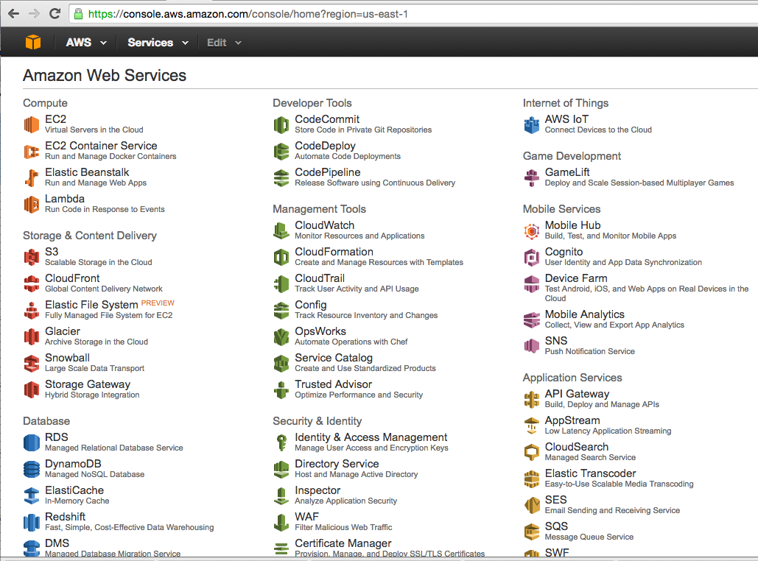
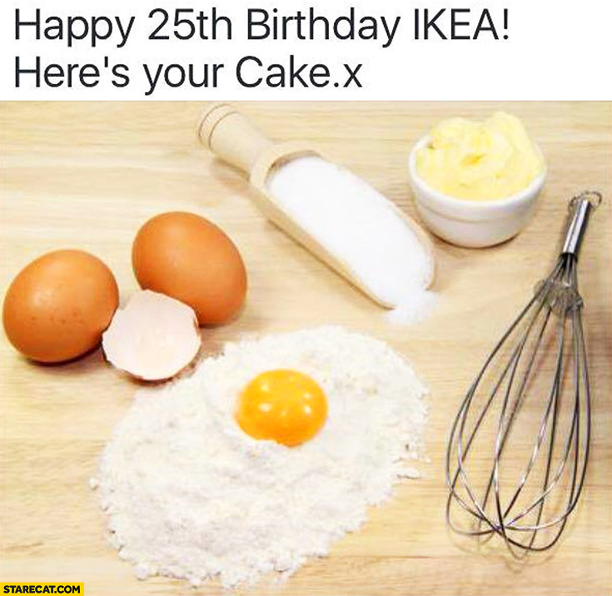
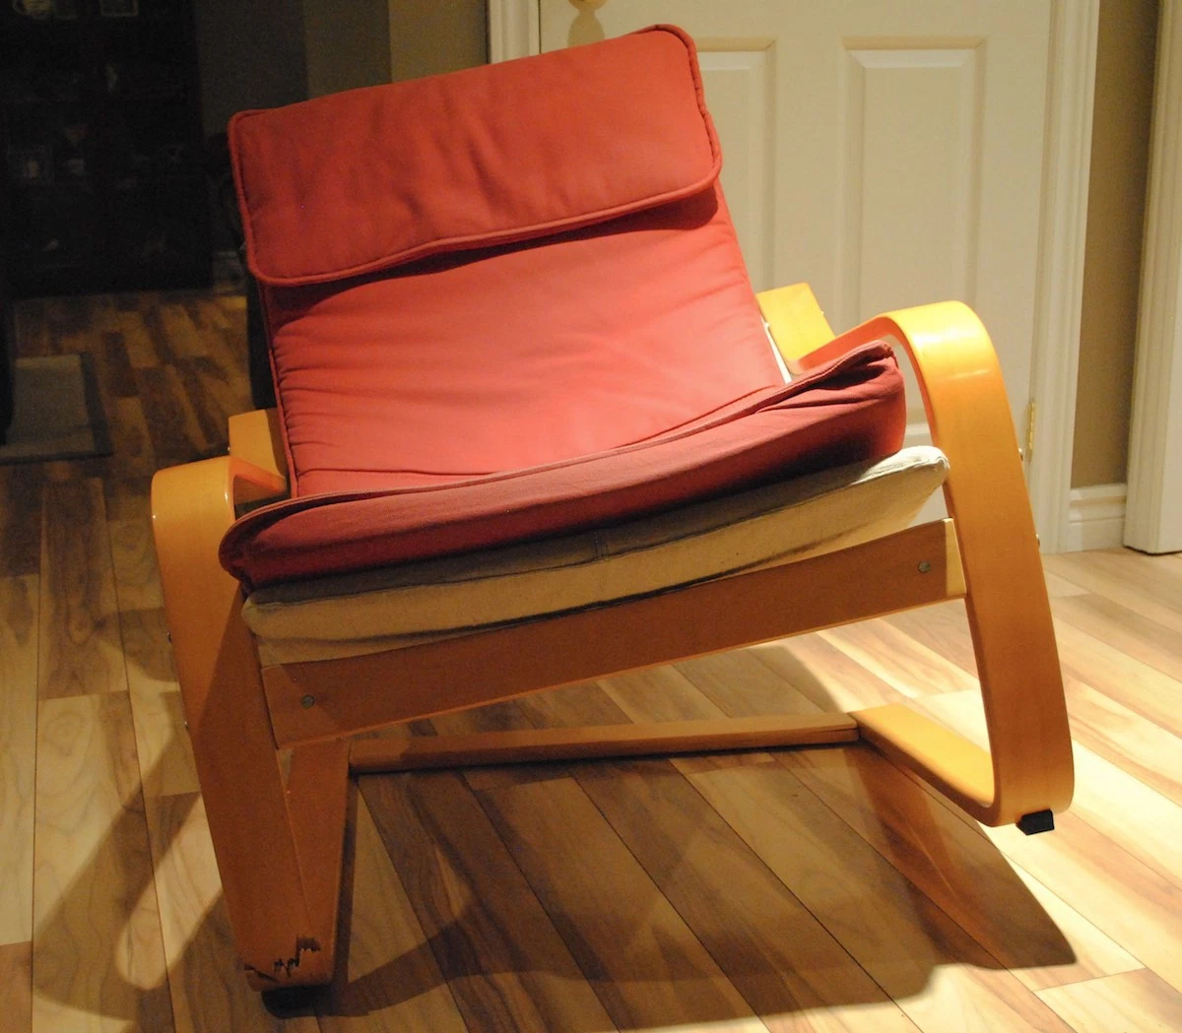

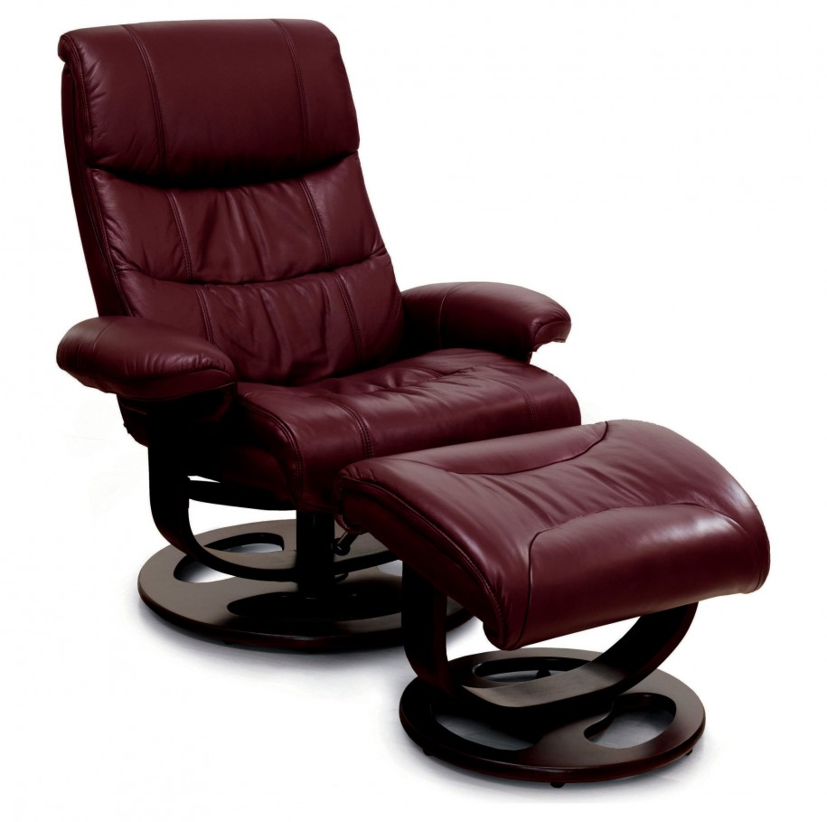
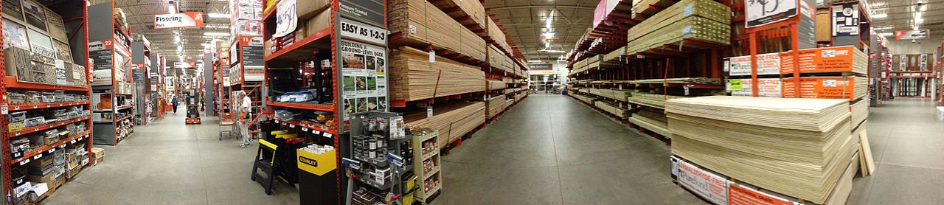
CyVerse: What the users are looking for
Notes:
You do not send a person looking for furniture/chair to home depot

Slide 6

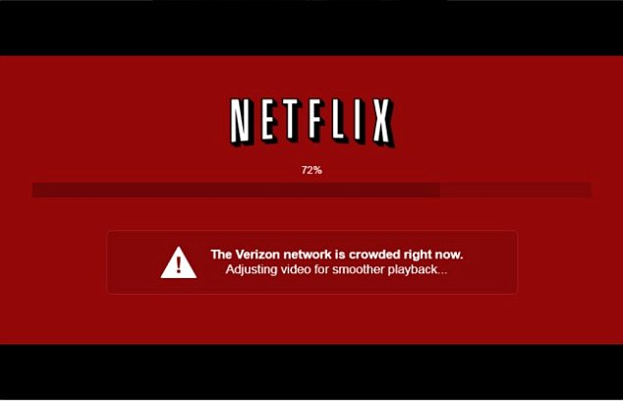
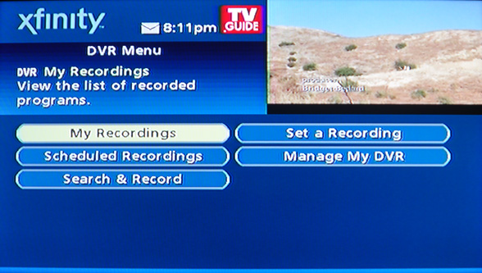
Expectation Management in the cloud
Notes:
It was hard to explain to my wife (who is a very technology savvy person) why a specific movie was not streaming but the other was
It was easier in the old days when you could blame specific pieces of technology …now its all you V/s cloud

Slide 7

Paradigm Shift from Producer to User Innovation
Open source book on his website & MIT Courseware online
Notes:
People who suffer the most are uniquely equipped to to solve a given problem, We are trying fuel that user driven innovation as there are many “producers” e.g. Amazon, XSEDE, campus HPC

Slide 8
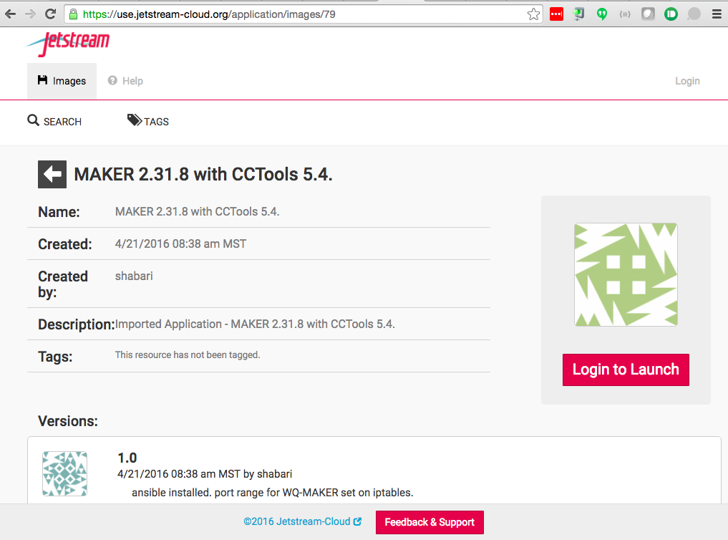
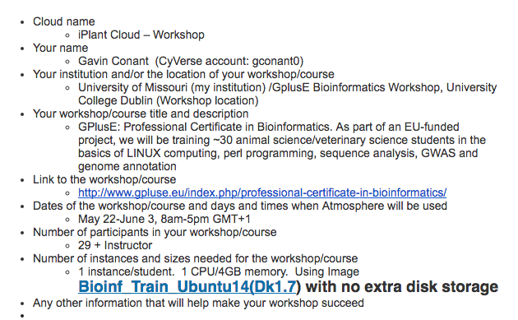
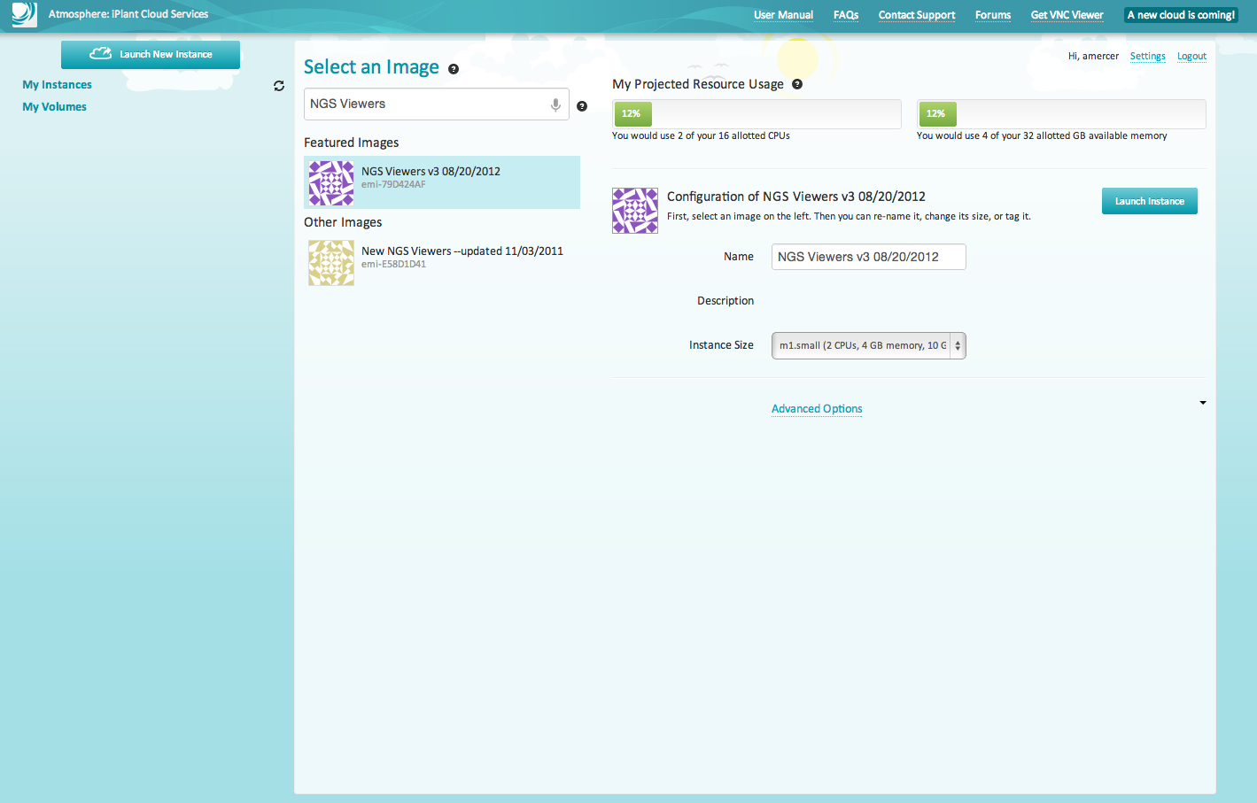

Empowering users: CyVerse Atmosphere (a managed cloud)

Slide 9
Cloud Computing
Not a singular technology component
Not a black box or alien technology
Not a “elixir of scalability”, “panacea for Big Data” etc.
It cannot keep growing and scaling without planning (and architecting your application)
Unfortunate victim of marketing hype
Further complicated by use of jargon, TLA, private cloud, community cloud, hybrid cloud …

Slide 10
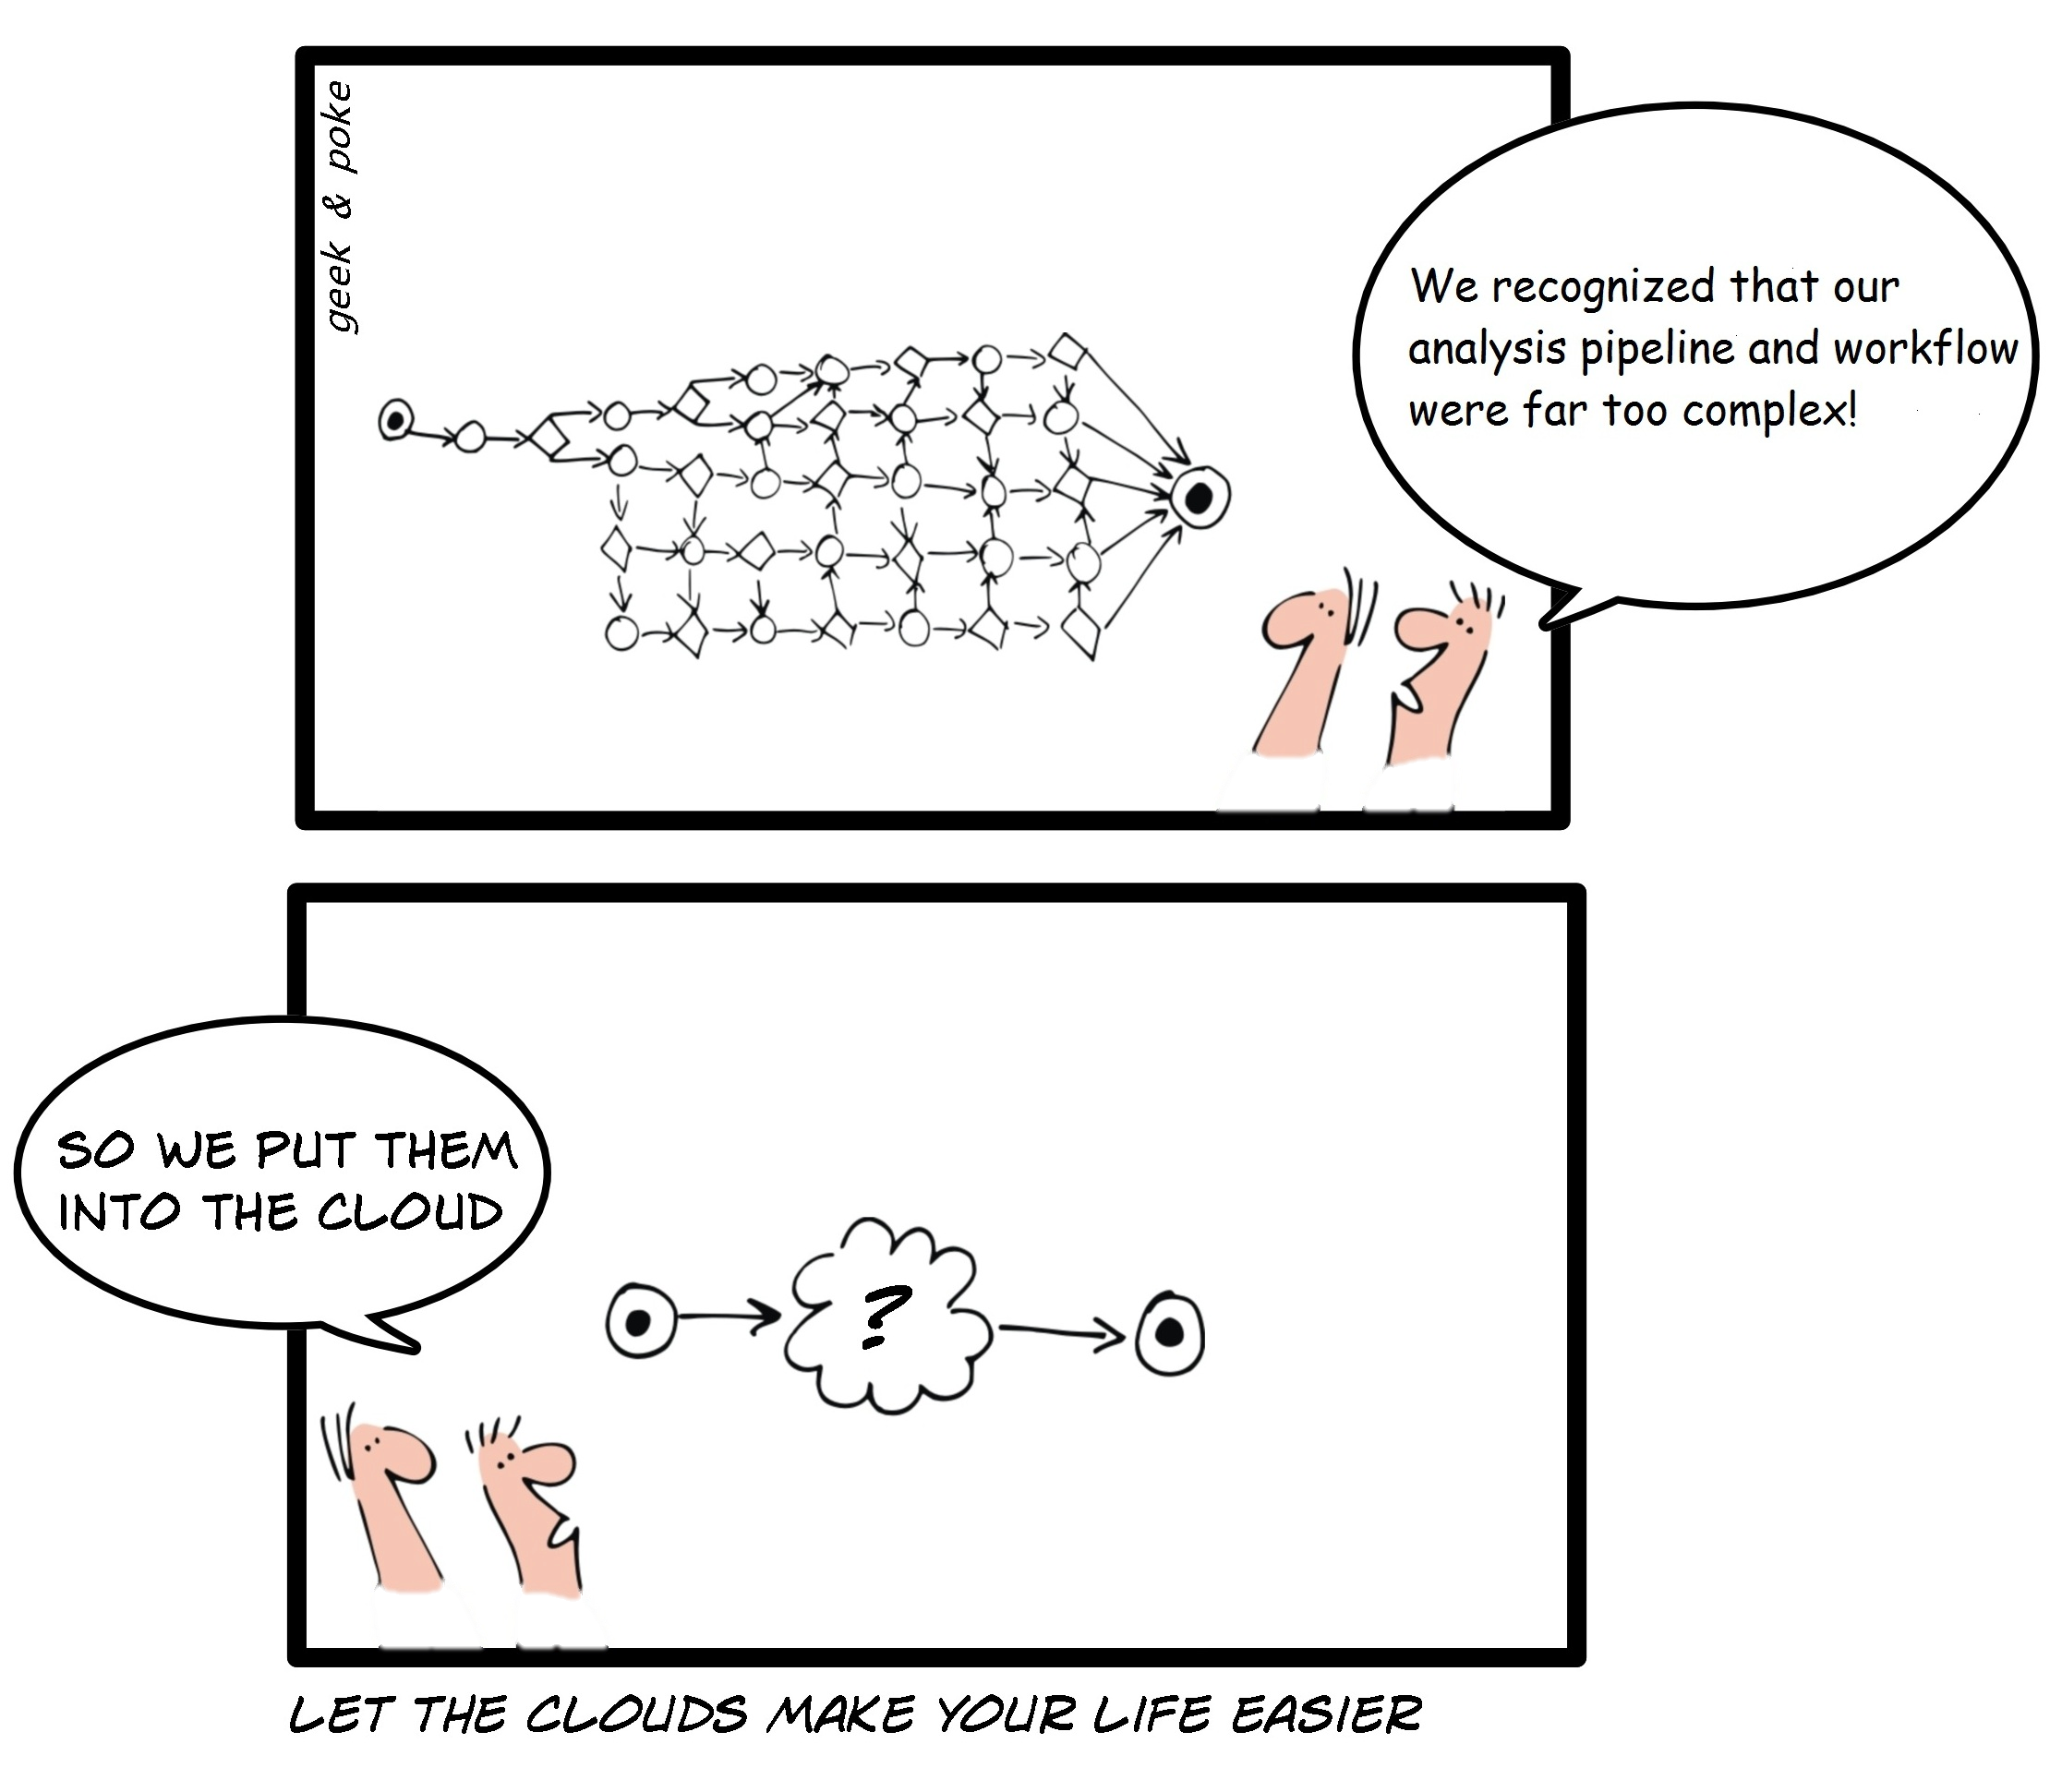
What is cloud computing ?
http://geekandpoke.typepad.com/geekandpoke/2009/03/let-the-clouds-make-your-life-easier.html

Slide 11
Cloud Computing…is
Amazingly flexible technology
It’s a platform that comprise of many uniquely flexible components
Allows us to create “purpose built appliances”
Allows us to finally “script our infrastructure”
Allows mixing and matching of components that you need to do your science
Opens up many new avenues and approaches for teaching topics that require complex (pre configured) software tools and data

Slide 12
Covering cloud concepts:
Beginners:
Typically looking for a “bigger” laptop or desktop in the “cloud”
Need admin/sudo privileges to customize software installation (and local IT will not give it)
Intermediate:
Typically Looking for custom components (sql, web application server)
Need to manage workflows (analysis pipelines)
Advanced:
Technology specific (spark, yarn etc.)
Need to manage lifecycle of application and data
Edge computing needs

Slide 13
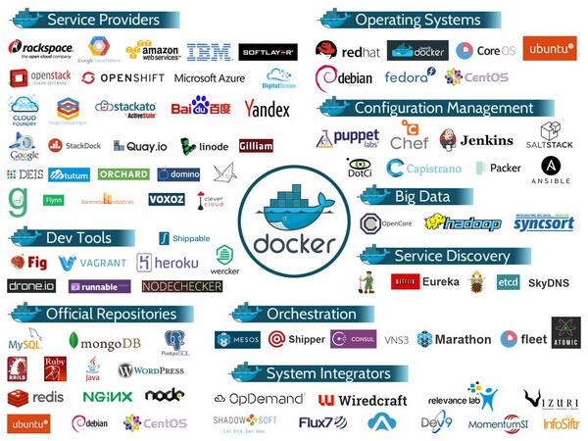
The landscape: Do not get distracted

Slide 14
Cloud Computing Zen
Don’t get frustrated…
This is cutting (bleeding) edge technology
There will be plenty of WTF#$@ moments
Be patient…
Instructions/infrastructure keep changing (s/w version)
Be flexible…
There will be unanticipated issues along the way
Be constructive…
Use wiki, forums and share knowledge
Make everyone’s experience better
Be creative…
There is more than one way to do it (TIM-TOWTDI)

Slide 15
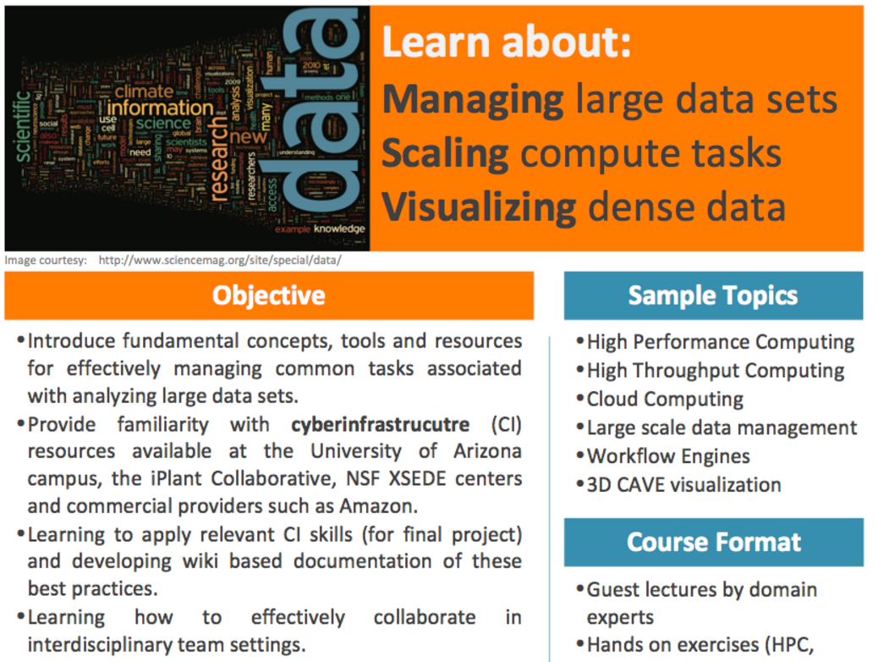

Applied Cyberinfrastructure Concepts
Distributed Computing
High-performance Computing
Data Management
Code Management
Virtualization
Documentation
Team Science
Interdisciplinary Teams
Communication
Teamwork
Responsibility
Collaboration
I hate people
Teamwork
Responsibility
Collaboration
Communication
?

Slide 16
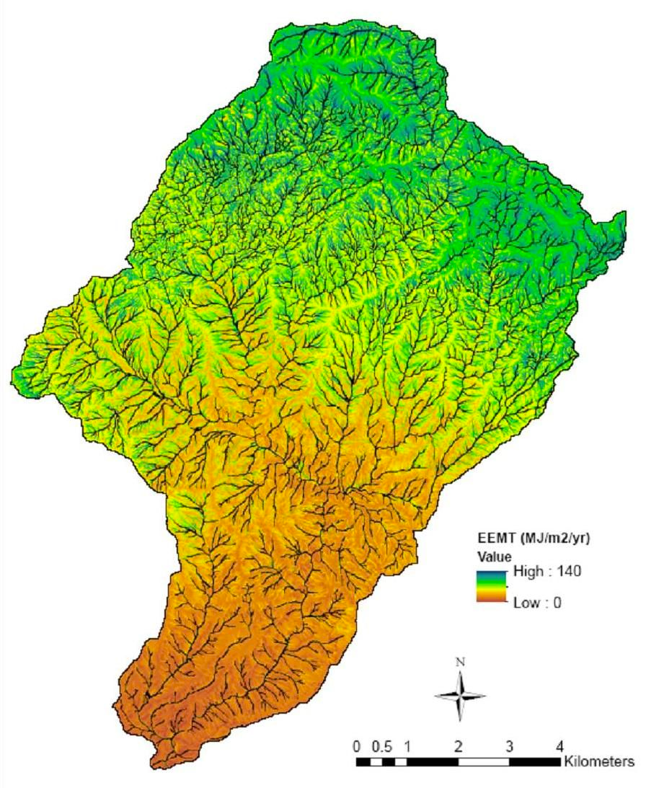
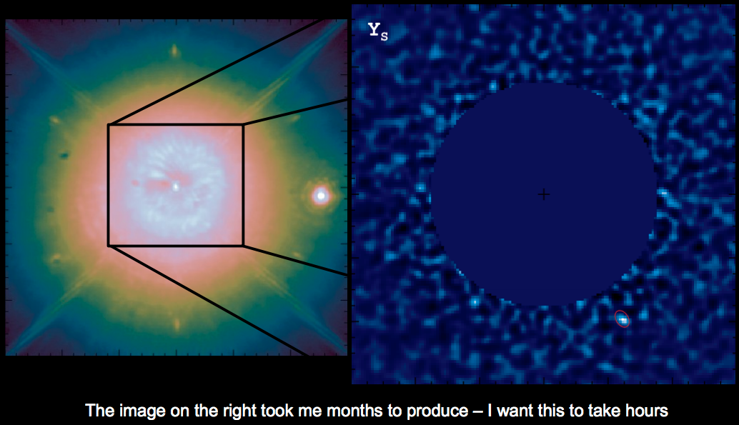
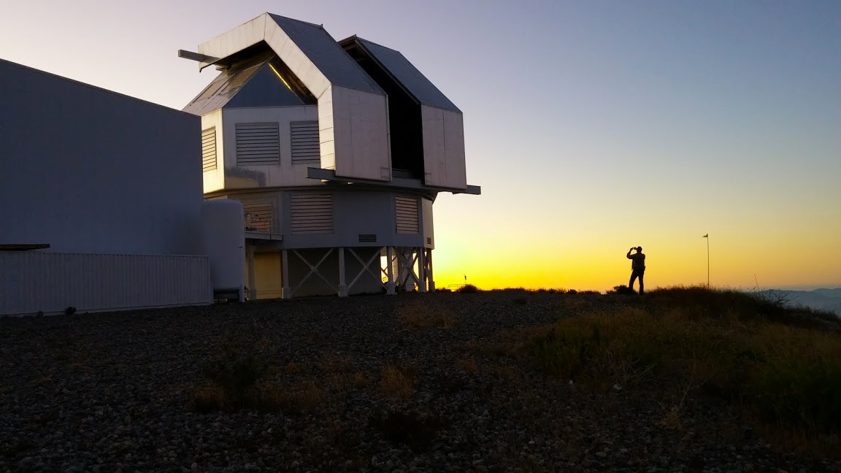
Project based Learning
Annotating 12 Rice Genomes (2012)
Ground water movement simulation (2013)
Ecosystem energy mass transfer (2014)
Exoplanet hunting (2015)
Dynamic Mapping of Mosquito (Zika) Abundance (2016)

Slide 17
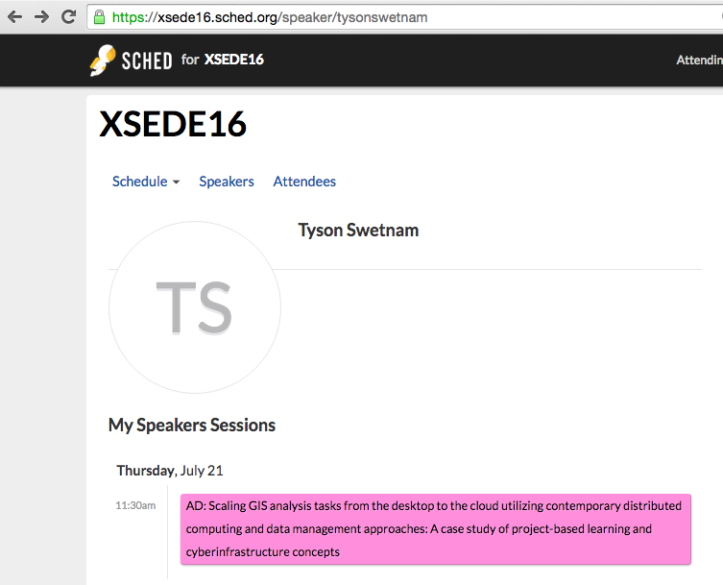
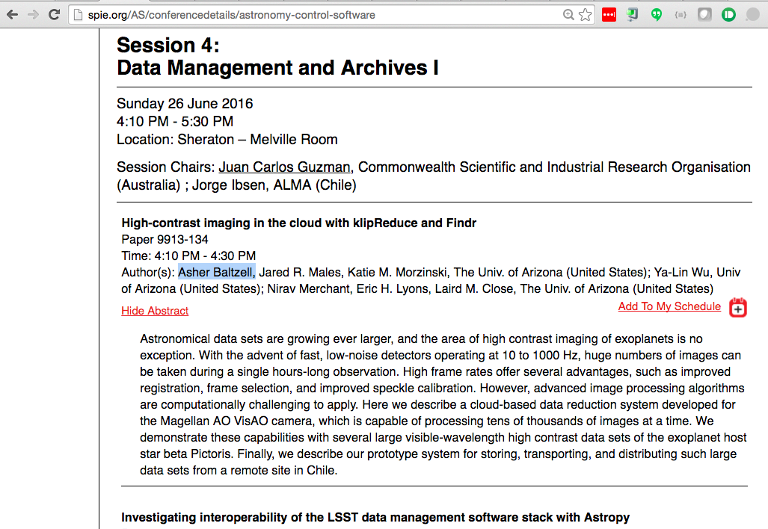
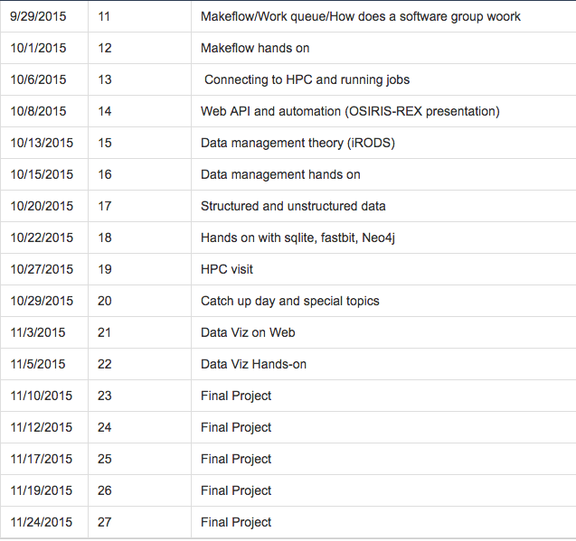
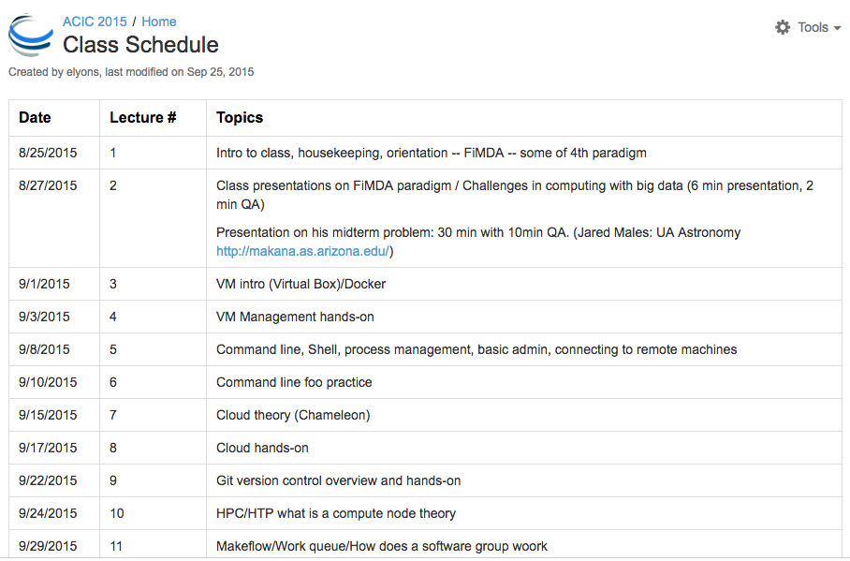
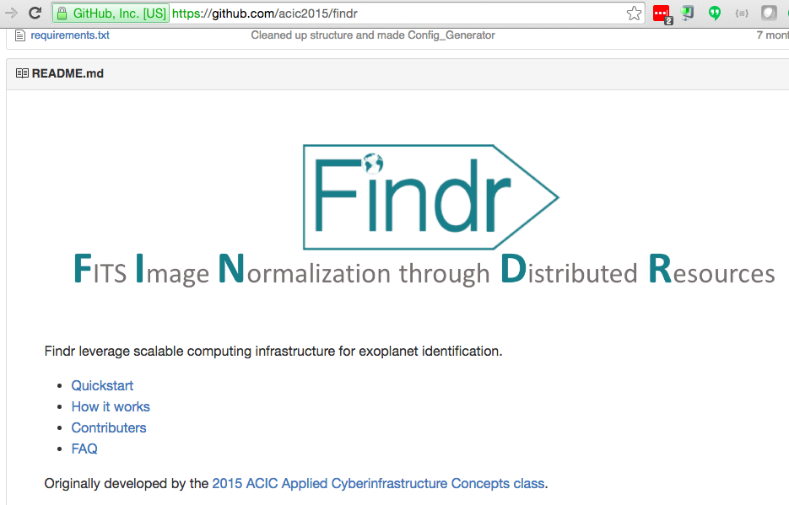
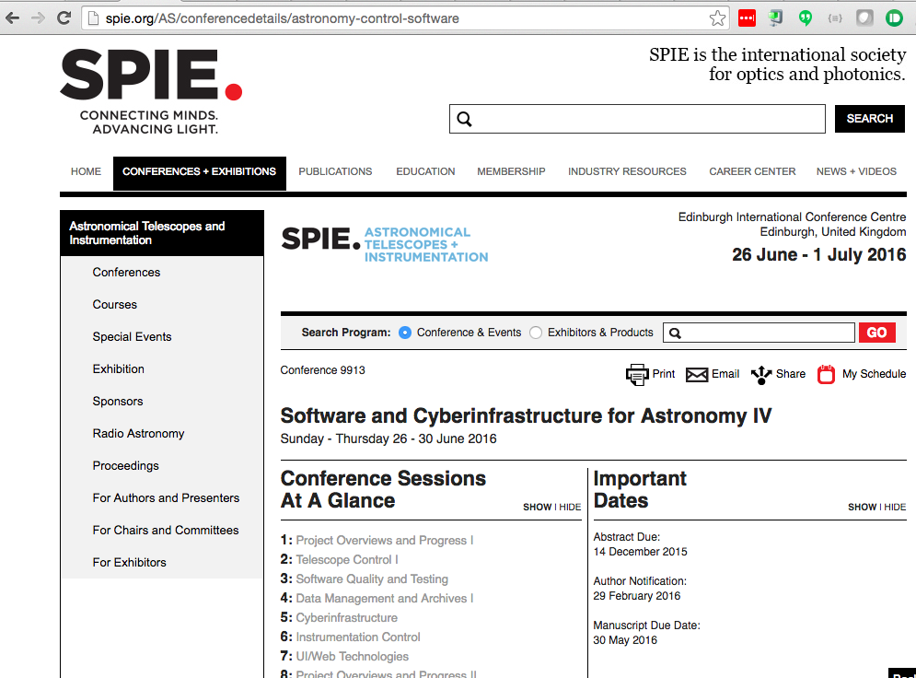
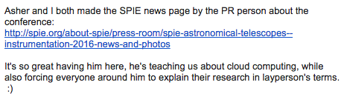
Topic Coverage:
From ideas to solutions (in the cloud)
Notes:
Tyson is a field ecologist, Asher is a student in genetics and end of they day the scientists/clients learn a lot as well.

Slide 18
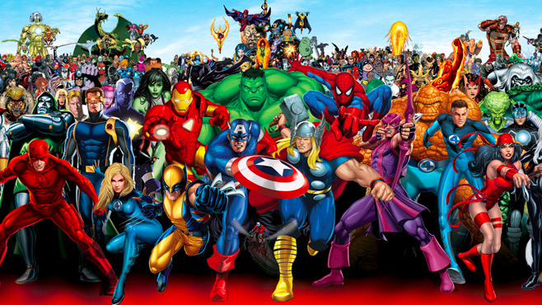
Scaling users and Ideas

