Slide 1

The NIH Data Commons: A Cloud-based Training Environment
Philip E. Bourne, Ph.D. FACMI
Associate Director for Data Science
National Institutes of Health
Slides adapted from Vivien Bonazzi

Slide 2
Agenda
Why cloud based training is important to the NIH
What the NIH is doing to support it

Slide 3
The Data Commons is an NIH endorsed platform that fosters the development of a digital ecosystem

Slide 4
That digital ecosystem allows transactions to occur on FAIR data* at scale * http://www.ncbi.nlm.nih.gov/pubmed/26978244

Slide 5
Data Commons is a Platform that fosters development of a digital Ecosystem Treats products of research – data, software, methods, papers, training materials etc. as a digital asset (object) Digital objects need to conform to FAIR principles - Findable, Accessible, Interoperable, Reproducible Digital objects exist in a shared virtual space (initial) - Find, Deposit, Manage, Share and Reuse: digital assets Enables interactions between Producers and Consumers of digital assets Gives currency to digital assets and the people who develop and support them

Slide 6

To understand the Data Commons Platform (and how it works for biomedical data) we need to use a Platform stack to help visualize the concept
Notes:
Framework helps visualize the concept of the platform

Slide 7
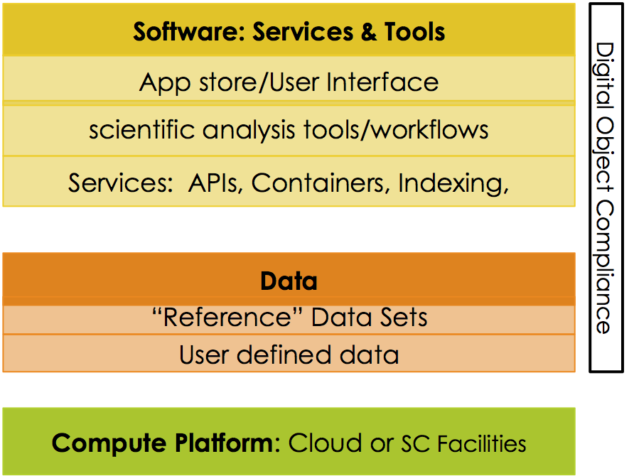
NIH Data Commons - Platform Stack
https://datascience.nih.gov/commons

Slide 8
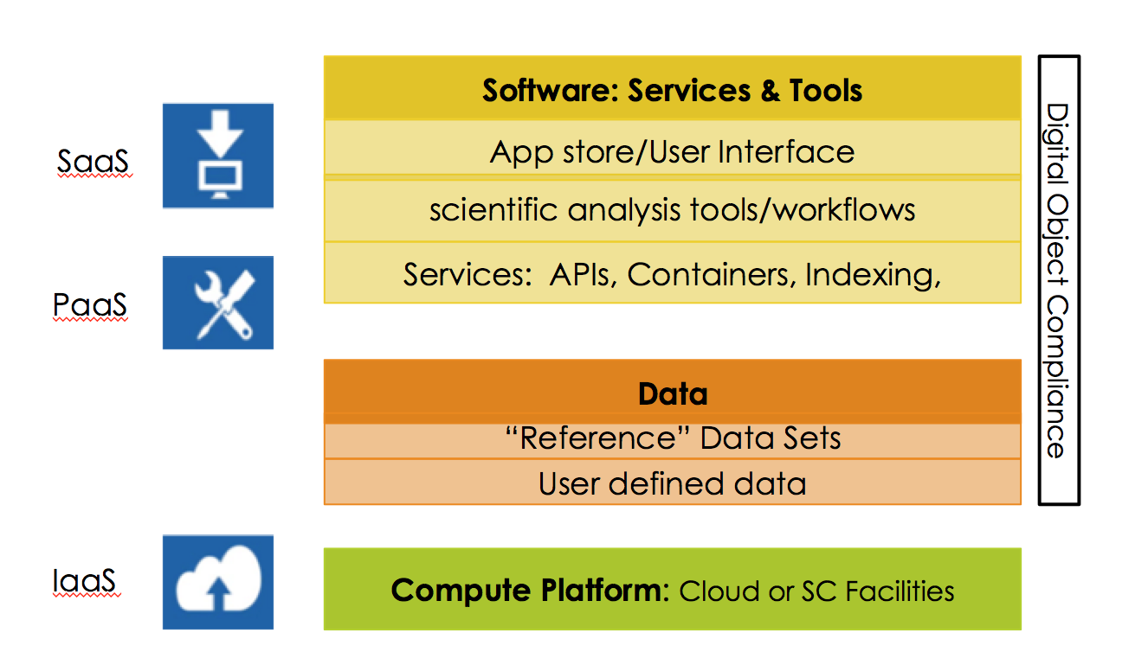
NIH Data Commons - Platform Stack
https://datascience.nih.gov/commons

Slide 9
NIH Data Commons - Platform Stack
Network/Community
Market Place
Digital Market Place, Bazaar, Community
Technology
Data
Sangeet Paul Choudary – Platform Scale

Slide 10
NIH Data Commons Pilots

Slide 11
Current Data Commons Pilots
Commons Stack Pilots
Explore feasibility of the Commons Platform (FW)
Provide data objects to populate the Commons
Facilitate collaboration and interoperability
Cloud Credit Model
Provide access to cloud (IaaS) and PaaS/SaaS via credits
Connecting credits to NIH Grant
Reference Data Sets
Making large and/or high value NIH funded data sets and tool accessible in the cloud
Resource Search & Index
Developing Data & Software Indexing methods
Leveraging BD2K efforts bioCADDIE et al
Collaborating with external groups

Slide 12
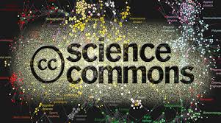

Data Commons Pilot – connecting the pieces
Co-location of large and/or highly utilized NIH funded data on the cloud
+ commonly used tools for analyzing and sharing digital objects
to create an interoperable resource for the research community.
Investigators will be able to collaborate and share digital objects within this environment and connect with others

Slide 13
Educational Opportunities

Slide 14
Goal: To strengthen the ability of a diverse biomedical workforce to develop and benefit from data science
Discovery of Educational Resources
BD2K Training Coordination Center
Strengthening a diverse biomedical workforce to utilize data science
BD2K funding of Short Courses and Open Educational Resources
Building a diverse workforce in biomedical data science
BD2K Training programs and Individual Career Awards
Fostering Collaborations
BD2K Training Coordination Center, NSF/NIH IDEAs Lab
Expanding NIH Data Science Workforce Development Center
Local courses, e.g. Software Carpentry
Notes:
Short term: produce a searchable catalog of physical and virtual courses; Funding diversity awards to work with BD2K Centers; Expand IRP training started Jan 2015 e.g. Software carpentry and Train the trainers
Long term: evaluation

Slide 15
Thank you
ADDS Office
- Vivien Bonazzi, Michelle Dunn, Jennie Larkin, Mark Guyer, Sonynka Ngosso
NCBI: George Komatsoulis
NHGRI: Valentina di Francesco
NIGMS: Susan Gregurik
CIT: Andrea Norris, Debbie Sinmao,
NCI: Warren Kibbe, Tony Kerlavage, Tanja Davidsen, Ian Fore
NIAID: JJ McGowan, Nick Weber, Darrell Hurt, Maria Giovanni, Alison Yao
The NIH Common Fund: Betsy Wilder, Jim Anderson, Leslie Derr
Trans NIH BD2K Executive Committee & Working groups
Many biomedical researchers, cloud providers, IT professionals

